Slide 1
Teaching and Technology
Pratt Institute | 2015

Slide 2
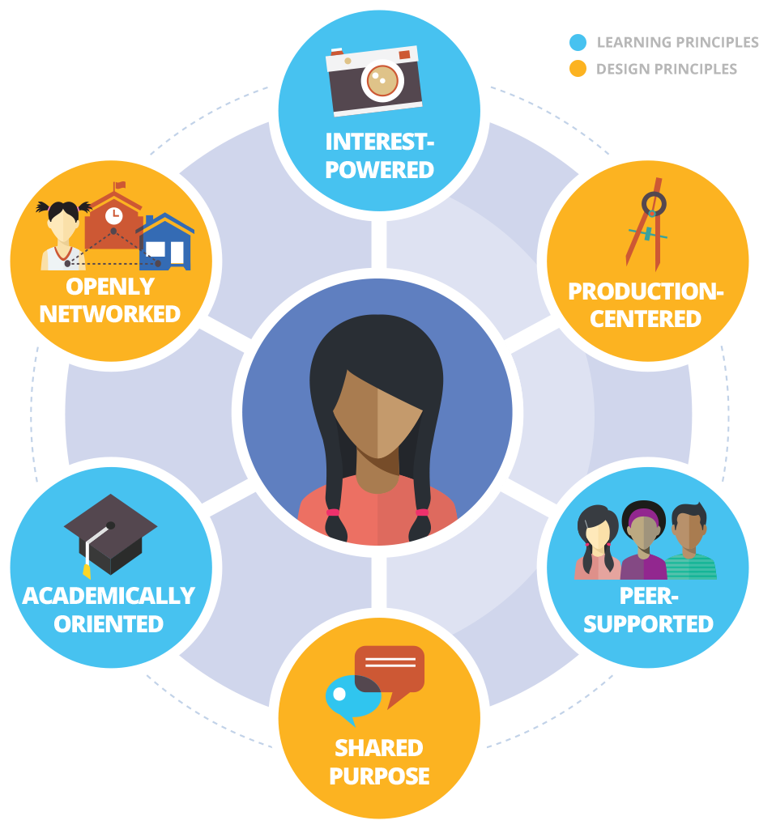
Digital Art Pedagogies
Connected Learning:
Teacher Agency
Interest-Driven Learning
Peer-Supported Learning
Openly Networked Classrooms

Slide 3
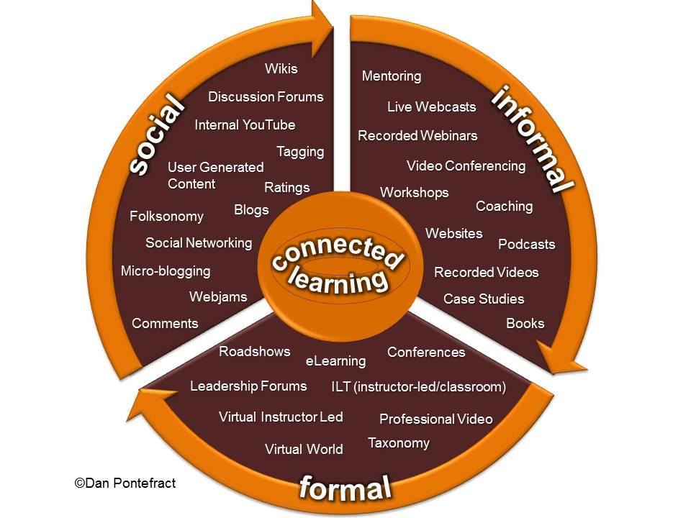
Interfaces & Platforms
Learning Management Systems
Collaborative Learning
DIY Web Design
Assistive Technologies
Learning Resources & Digital Museums
Games and Play

Slide 4
Digital Tools, Software and Hardware
Hardware
Software
Online Tools
Social Media
Tablet Apps

Slide 5
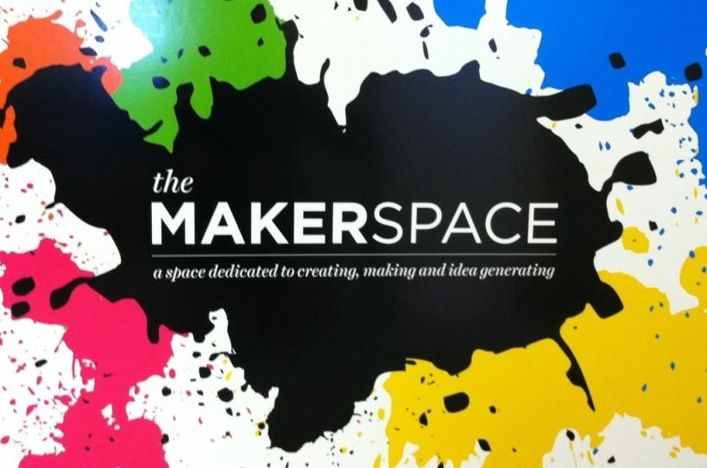
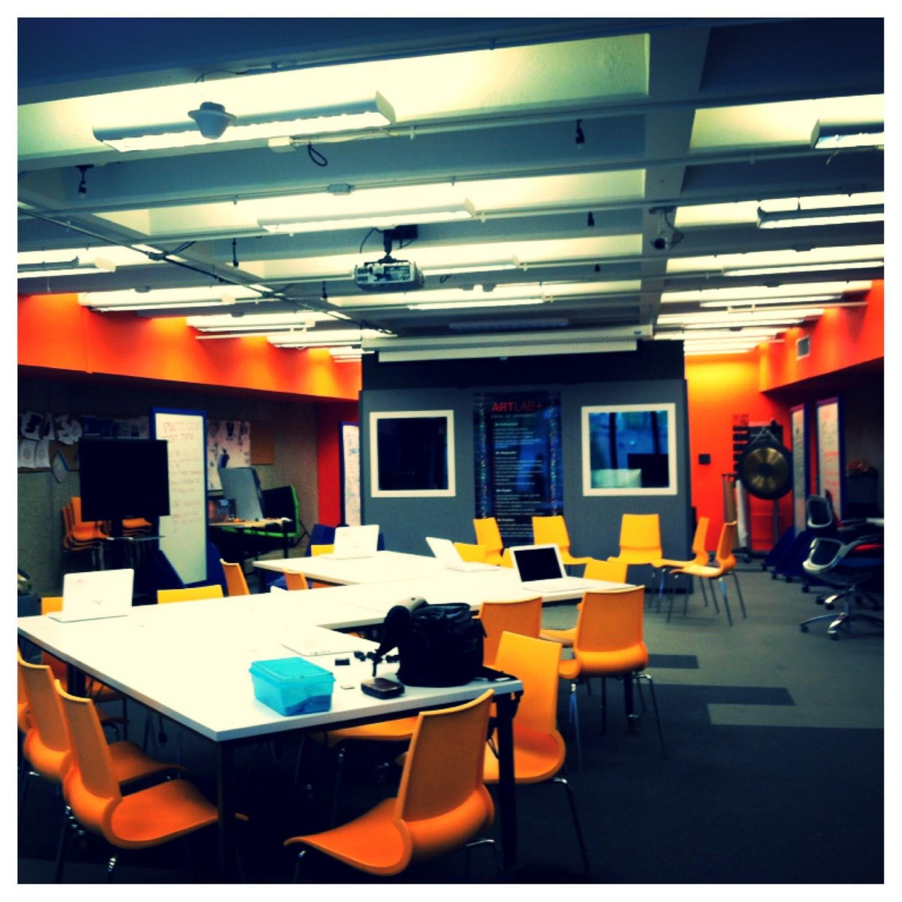
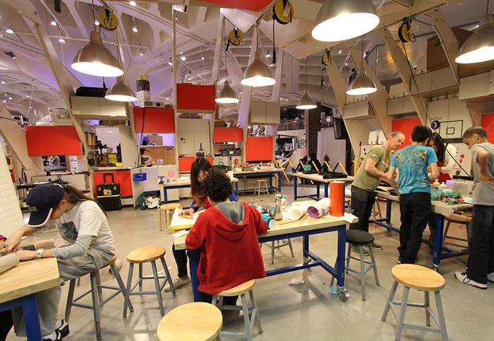
Connected Learning Environments
Engaged Classrooms
Inclusion: Working with Special Needs Populations
Museums and Cultural Spaces
Family & Community Partnerships

Slide 6
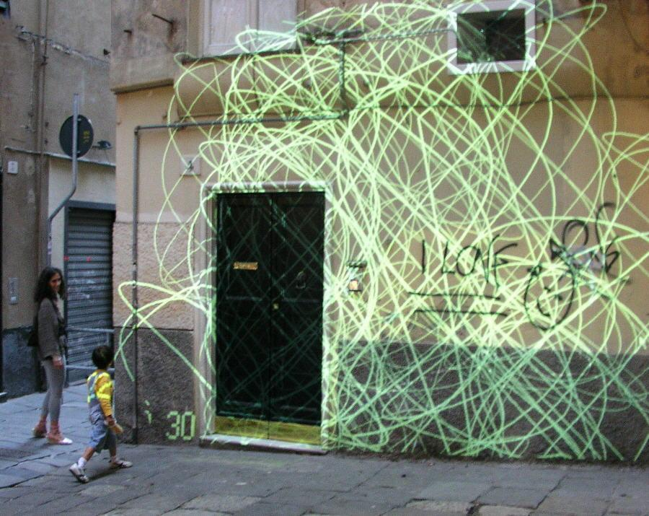
Digital Art and New Media Literacies
Historical and contemporary examples of digital art making
Maurizio Bolognini

Slide 7
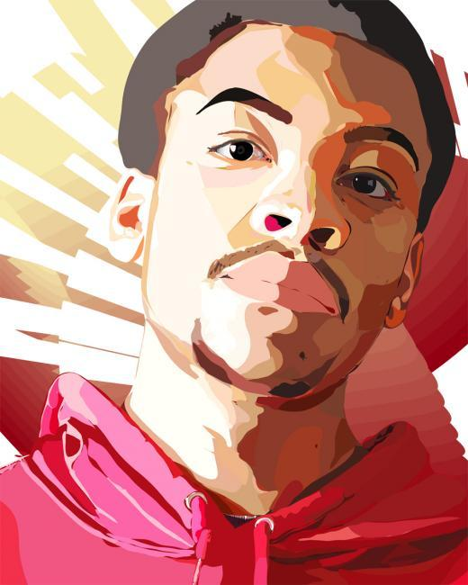
PhotoLab
Digital Imaging
Photoshop Experiments
GIF Generators and Animations

Slide 8
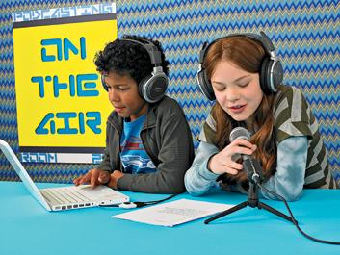
SoundLab
Field Recordings
Oral Histories and Podcast
Musical Experiments
DIY Radio & Digital Tools

Slide 9
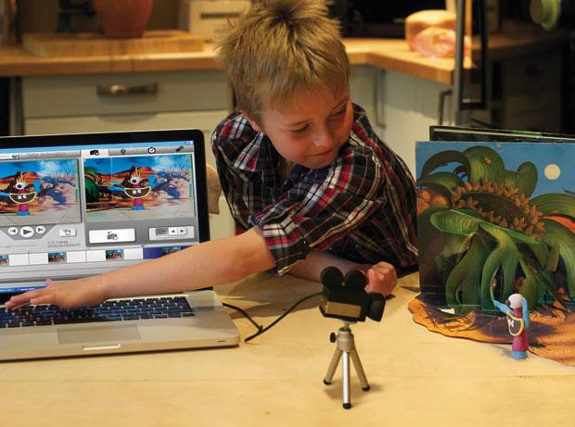
FilmLab
Basics of Filmmaking with Youth
Stop-Motion
Flipbooks and Phenakistoscopes
Using Digital Tools

Slide 10
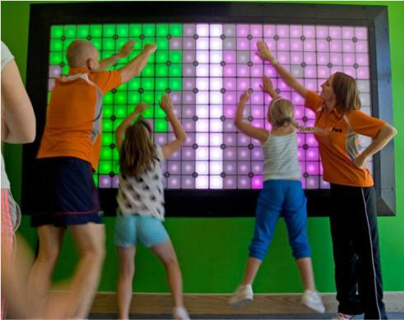
Interactive Technology and Participatory Design
Basics of Web Design
Digital Storytelling & Social Media
Game Play
Participatory Art
Physical Computing

Slide 11
Final Project
Individual or Group-based:
ArtTECH: Project-Based Learning
MakerSpace: Learning Plan
Net.Artwork: Digital Artwork & Lesson Plan

