Slide 1
Digital Art Pedagogies
Pratt Institute | Spring 2015

Slide 2
Concepts + Strategies
Blended Learning
face-to-face learning + digital content
Flipped Classroom
Instruction out of school; Homework in school
Digital Studio / MakerSpace
Hanging out, messing around, geeking out (HOMANGO)

Slide 3
Blended Learning

Slide 4
Flipped
Classroom

Slide 5
HOMANGO

Slide 6
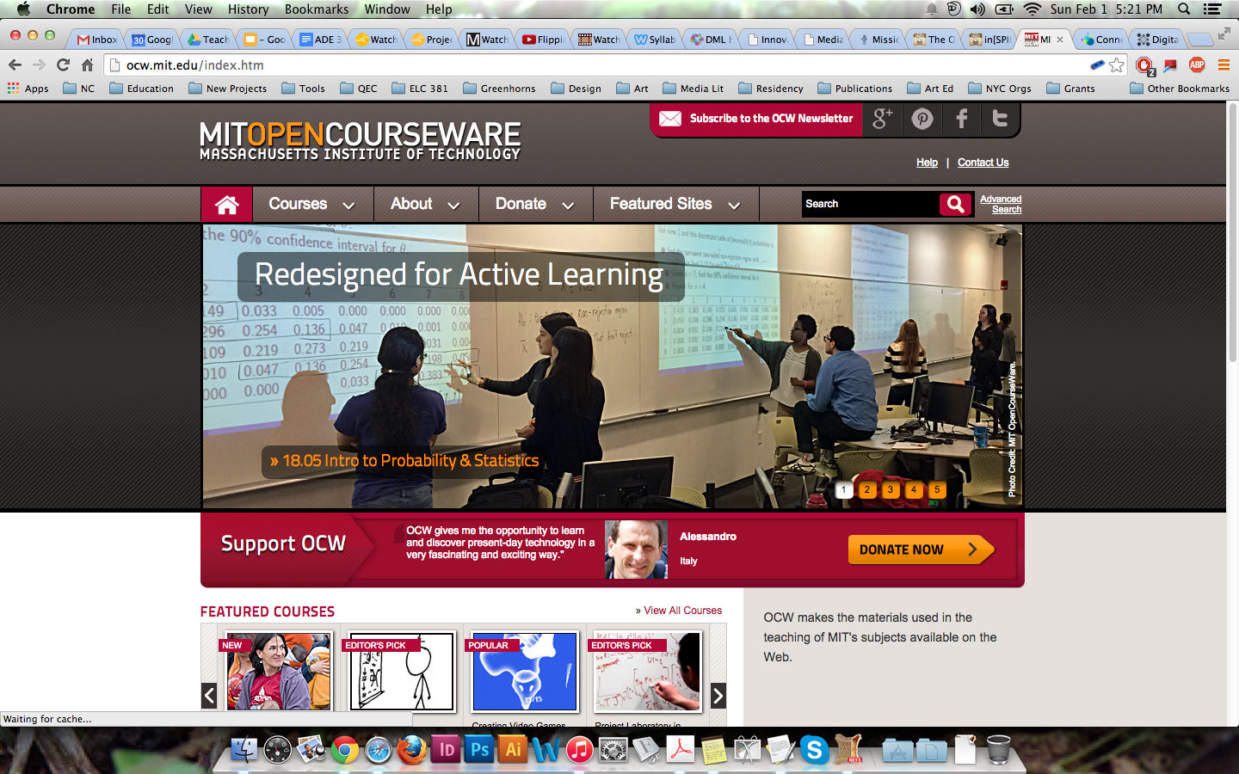
4. Open Learning
Online learning communities
Making content publ
MIT opencourseware
Innovation Challenge

Slide 7
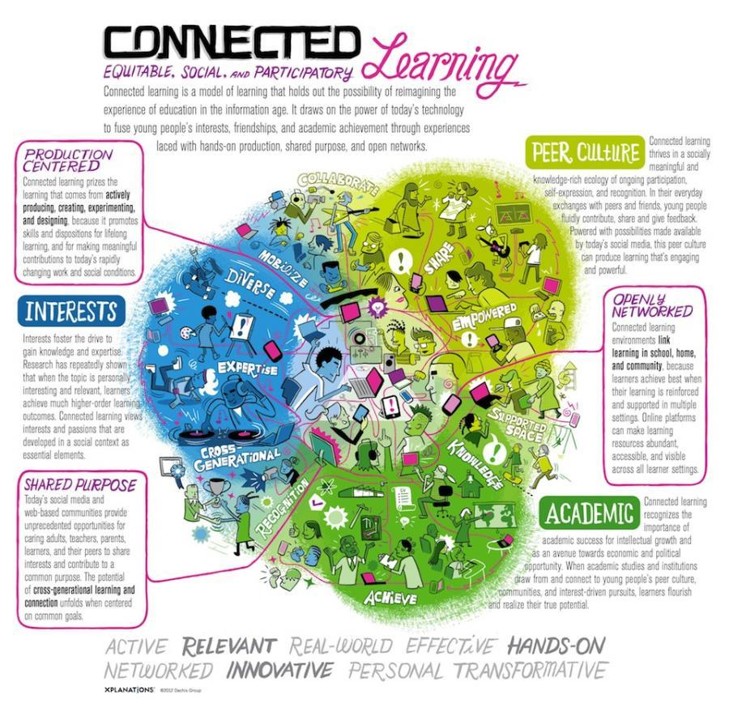
5. Connected Learning
Learning Principles:
Interest-powered
Peer-supported
Academically oriented
Design Principles
Production-centered
Openly networked
Shared purpose
Institute of Play Video
Quest to Learn Video

Slide 8
What do these strategies have in common? How do they differ?

Slide 9
Challenges to Digital Arts Pedagogy
Not enough time
Obsolescence and incompatibility
Competing forces of change and resistance
Online social networking and participatory culture
Technology pedagogy is not just about technology

Slide 10
Aims of art education in the 21st century
understanding new media, networking and creative capabilities of the Internet;
educating learners as global citizens;
cultivating compassionate teachers;
conceptualizing this work as eclectic and incomplete.

Slide 11
New Media?
A "media ecology where more traditional media, such as books, television, and radio, are converging with digital media, specifically interactive media and media for social communication"
What are new media literacies?

Slide 12
Cultivating Media Literacy
Understanding how media operates within social systems and popular culture
Critiquing and seeing media in new ways
Creating your own media
Media literacy requires the understanding that the development of art historians and artists (including tlie deconstruction of non-textual material) is directly related to formalism, semiotics, content, and aesthetics.

Slide 13
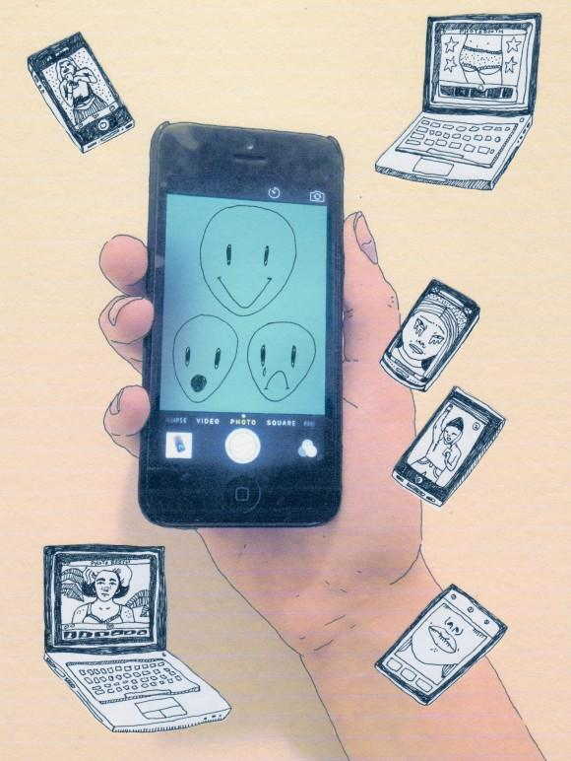
Contemporary Art+Tech Practices
Postmodern principles (from Olivia Gude):
Layering
Juxtapositioning
Hybridization
What else would you add?

Slide 14
Arts Technology Implementation
Do not focus on teaching the software. (lesson is project-driven.)
Teach students to be flexible about interfaces.
Emphasize pre-production.
Integrate traditional materials with the post-production process.

Slide 15
Arts Technology Implementation
Use the Internet for visual research.
Create a culture of responsible use.
Incorporate dialog about technology into your art discussions.
Introduce new media contemporary art.

Slide 16
Digital Self Portrait
Drawing
Digital Image

Slide 17
Scenario: Blended Learning / Flipped Classroom
Setting: Middle School in Bed-Stuy, Brooklyn
Challenge: You’re principal is asking all teachers to integrated flipped/blended learning ideas into their lesson plans and overall curriculum. How could you introduce this into the art classroom?

Slide 18
Scenario: Digital Studio / Makerspace
Setting: High School in the South Bronx
Challenge: Your school was just awarded a grant to transform the library into a “media commons” that will include sound/film production equipment, computers, tablets etc. How do you integrate this into your classroom and develop a studio-model to take advantage?

Slide 19
Scenario: Connected Learning
Setting: Elementary School - Astoria, Queens
Challenge: You work at a new charter school exploring themes of technology and global citizenship. The principal wants to see an overall strategy for how music and visual arts will use connected learning strategies in the classroom.

