Slide 1
Thesis 1
Approaches to Qualitative Research
Pratt Institute
Art and Design Education
Fall 2014

Slide 2
Overview
Exploring Inquiry
Positionality
Methodology
Methods
Data Collection
Sharing Findings
Examples + Getting Started

Slide 3
Exploring Inquiry
WHY RESEARCH?
Storytelling
Sharing a lived experience
Addressing a relevant challenge
Offering a meaningful interpretation
Art-making
Understanding the unknown
Properly conceptualized, qualitative inquiry becomes a civic, participatory, and collaborative project.
- Norman Denzin

Slide 4
What is qualitative research?
Qualitative inquiry is a process of describing, analyzing and interpreting insights discovered in everyday life.

Slide 5
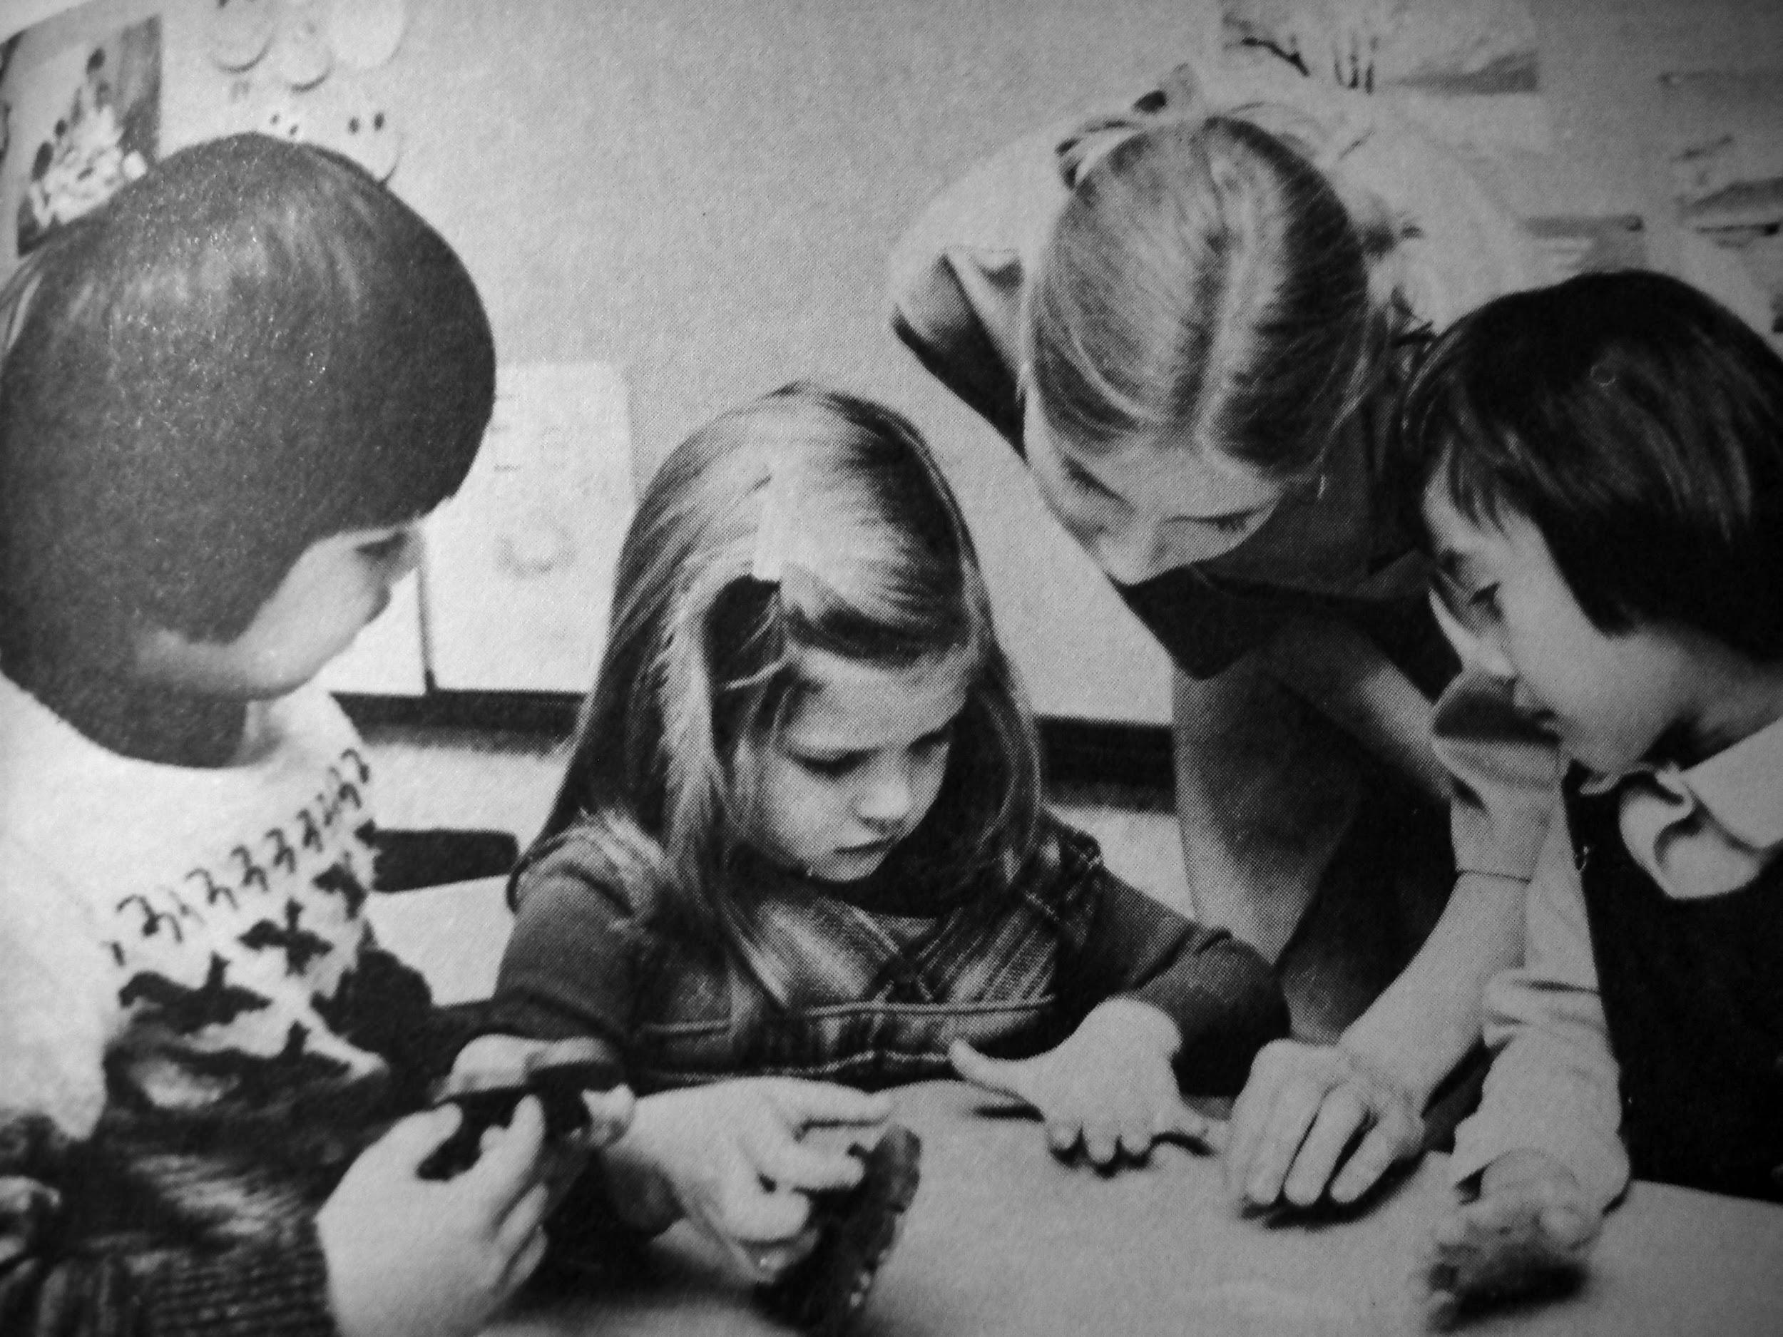

Slide 6
Positionality
Situating an identity as a scholar, artist, educator, community member etc.
Considering race, class, gender, ethnicity etc.
Understanding the power of the researcher and of research
Telling your story is important to the reader and your research

Slide 7
Positionality
Interpretive sufficiency: creating critical accounts that possess depth, emotionality, nuance and coherence.
Conscientization (Paulo Freire): the oppressed gain their own voice, and collaborate in transforming their culture.
Representational adequacy: free of racial, class and gender stereotyping – represent multiple voices to promote social transformation

Slide 8
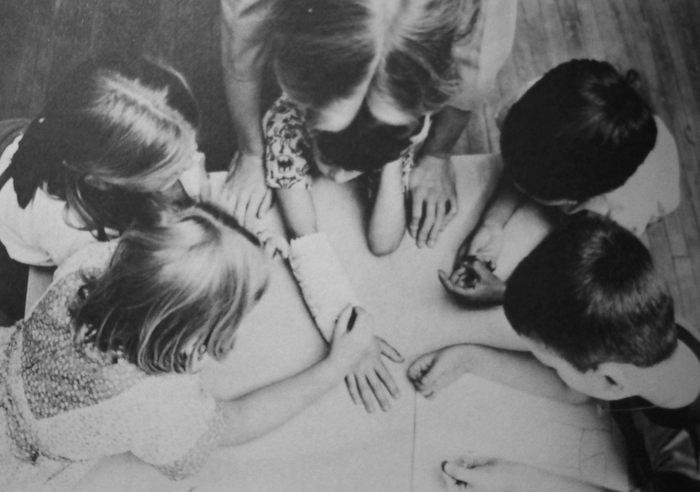

Slide 9
Methodology
Popular Qualitative Approaches:
Portraiture / Narrative Analysis
Ethnography
Arts Based / A/r/tography
Phenomenology
Grounded theory
Case study
Mixed Methods
Participatory Action

Slide 10
Portraiture +
Narrative Analysis
Narratives (storytelling) used as source of data
Narratives from one or more sources (e.g., interviews, literature, letters, diaries)
Creative storytelling as a method in sharing data/experiences
Scholar: Lawrence-Lightfoot

Slide 11
Ethnography
Oriented toward studying shared meanings and practices (i.e., culture, practices, routines and rituals)
Emphasizes the emic perspective - ie. “how local people think"
Can have a contemporary or historical focus
ie. Woman Without Class by Julie Bettie

Slide 12
Participatory Action Research
Emphasizes collective inquiry and experimentation grounded in experience and social history
Integrates: participation (life in society and democracy), action (engagement with experience and history), and research (soundness in thought and the growth of knowledge)
Ethical + logistical challenges

Slide 13
Arts Based / A/r/tography
Use of visual/creative interpretation of “data”, experiences or observations collected
Artworks used as a source of data
Art-making as a form of research and reflection
Collaborative form of inquiry that includes art as an essential element
Scholar: Rita Irwin

Slide 14
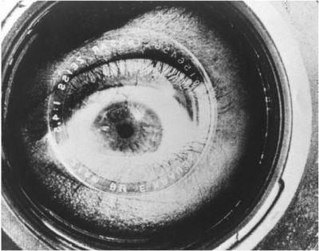
Phenomenology
Focuses on individual lived experiences, beliefs, and perceptions
Interpretive Process
Text used as a proxy
for human experience

Slide 15
Grounded theory
The study of a concept, not a descriptive study of a descriptive problem
Theorizing about how the world “is”, rather than how respondents “see” it
Uses systematic comparison of texts to build thematic structure and theory
Uses historical documents, interviews, texts, observations, videos etc.

Slide 16
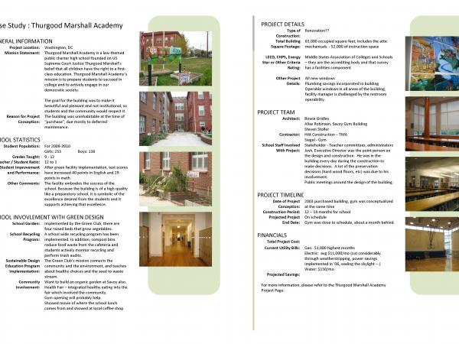
Case study
Analysis of one to several cases that are unique with respect to the research topic
Analysis primarily focused on exploring the unique quality of each case

Slide 17
Mixed Methods
Integrating quantitative and qualitative research methods in one study
Numbers + the stories behind them
Two most common designs are sequential and concurrent.

Slide 19
Qualitative Methods
Participant Observation
In-Depth Interviews
Focus Groups
Art making
Field Notes
Photo/Video Documentation
Autoethnography/Journaling
Surveys and Questionnaires

Slide 20
Data Collection (Participation and Observation)
Documentation
Coding, Finding Connections
Trustworthiness
Requesting Participation
Make sure permission/release forms are provided to participants
IRB Approval if human subjects are involved directly in research

Slide 21
Sharing + Developing your Findings
Making Art
Writing
Meditation
Reflection
Sharing with an audience - making research public
Creating an exhibition, website, artist book, performance or presentation

Slide 23
Getting Started
Determine Study’s Purpose
Choose a Primary Audience and consider Context
Consider Time Limits and Logistics + Focus Your Research Objective
Literature Review
Develop a Research Plan & Timeline

Slide 24
Getting Started
6. Choose an Approach (Methodology)
7. Focus on specific area of interest and choose methods
8. Begin Research + Participant Recruitment
9. Data Collection
10. Drawing Conclusions
11. Review, Revise, and Repeat

