Slide 1
Hardware & Apps
Teaching & Technology | Pratt Institute

Slide 2
Digital Youth Project Findings
Shift in social spaces - access, time, freedom
Youth culture, pop culture, peer learning connected
Messing around (tinkering) can lead to meaningful media production - embedded in social contexts
Interest-based communities <-> peer-based sharing and feedback

Slide 3
A Sampling of Digital Tools
Assessment / Classroom Management
Art Making & Process
Design (CAD)
Physical Computing

Slide 4
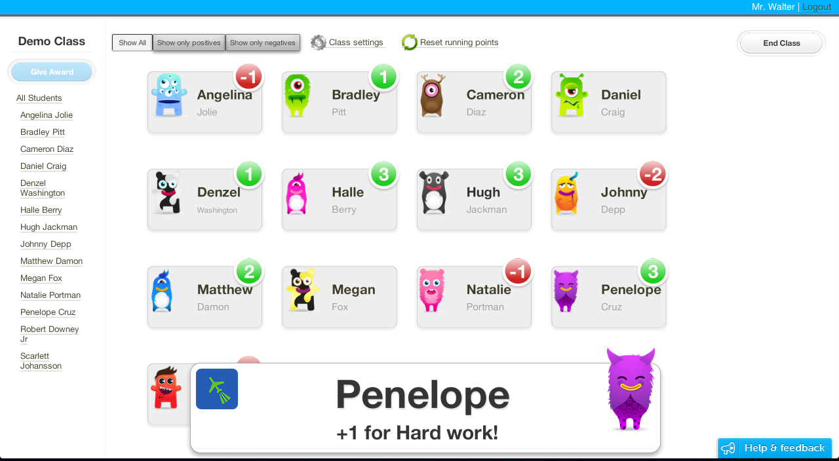
ClassDojo

Slide 5
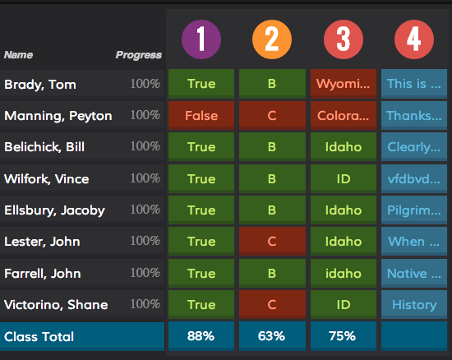
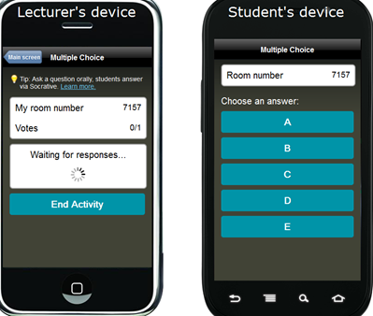
Socrative

Slide 6
Art & Art Making

Slide 7
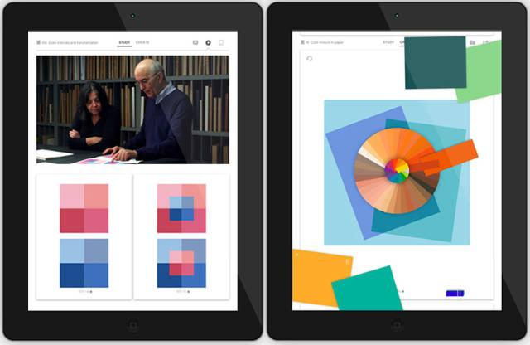
josef albers interaction of color app

Slide 8
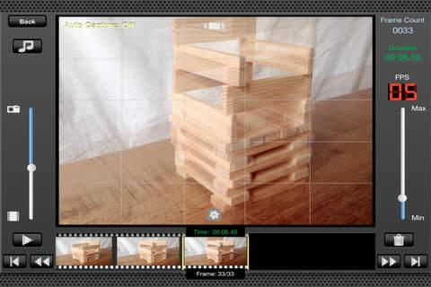
StoMo - Stop Motion App

Slide 9
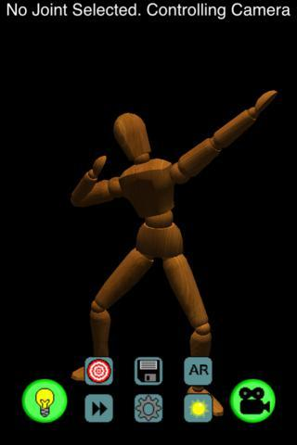
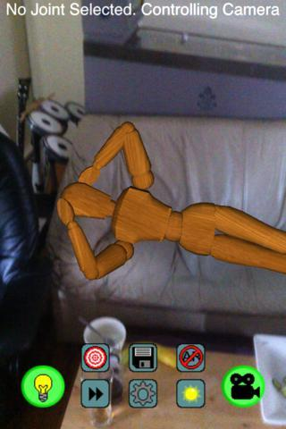
Wooden Doll App

Slide 10
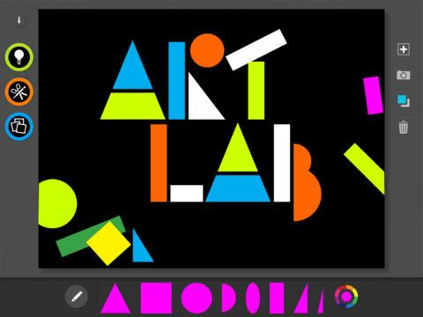
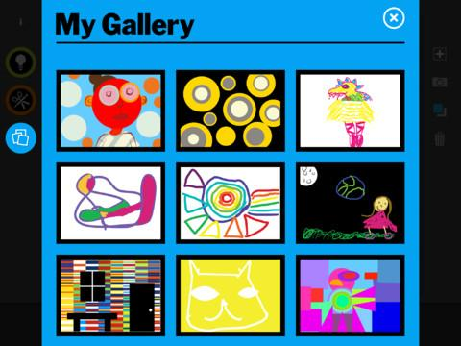
MoMA Art Lab App

Slide 11
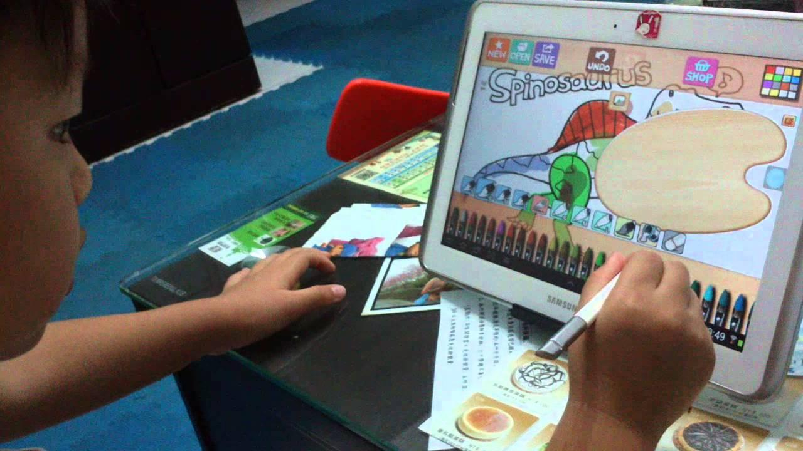
Hello Oil Painter App

Slide 12
VSB Art History App

Slide 13
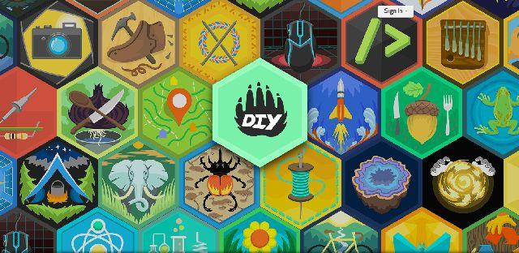
DIY Kids App

Slide 14
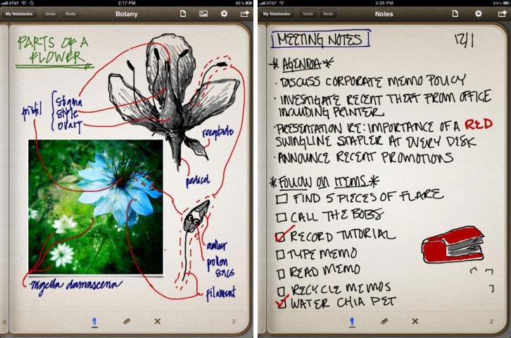
Penultimate App (Evernote)

Slide 15
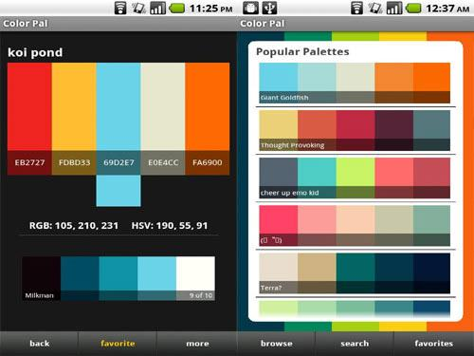
Color Palettes App

Slide 16
Design

Slide 17
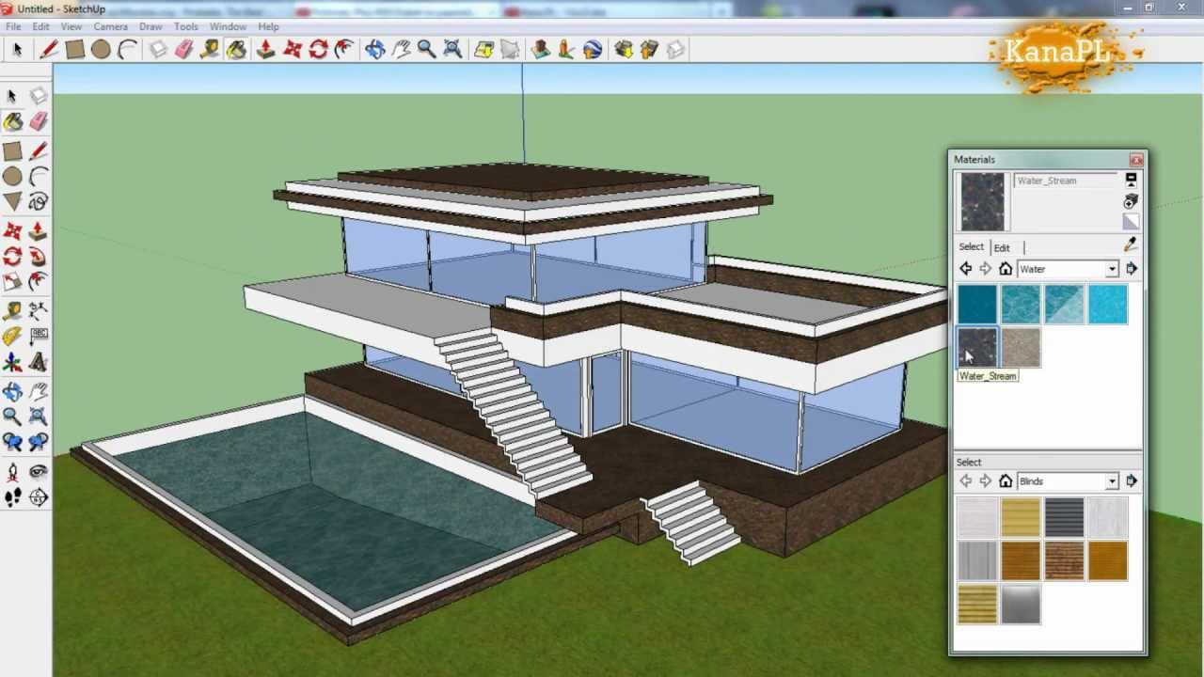
SketchUp

Slide 18
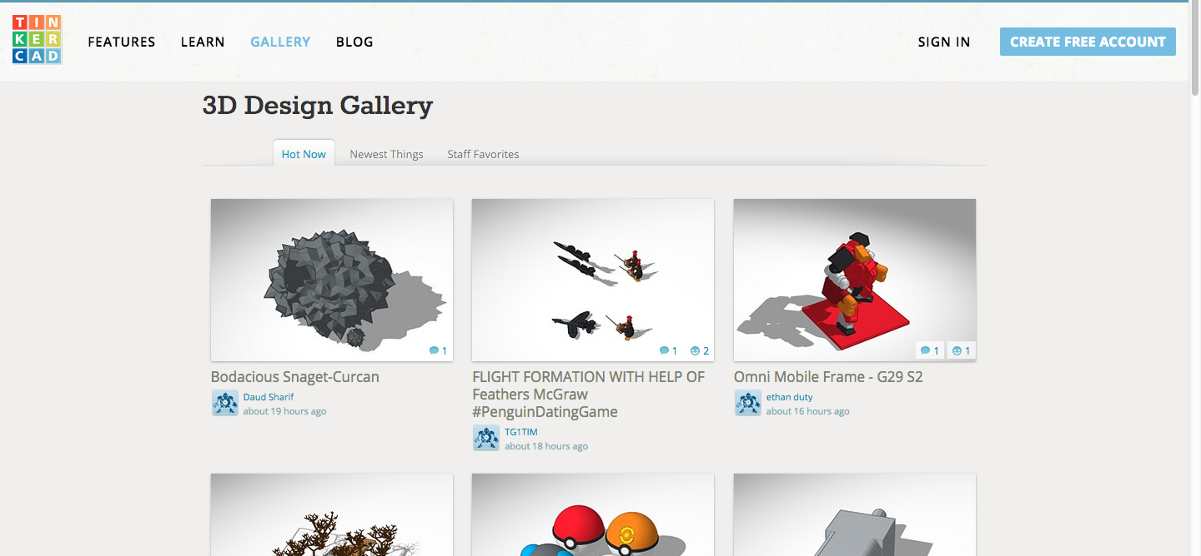
TinkerCAD

Slide 19
Physical Computing

Slide 20
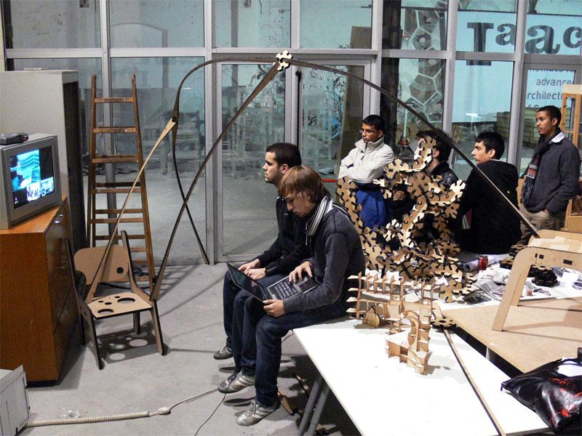
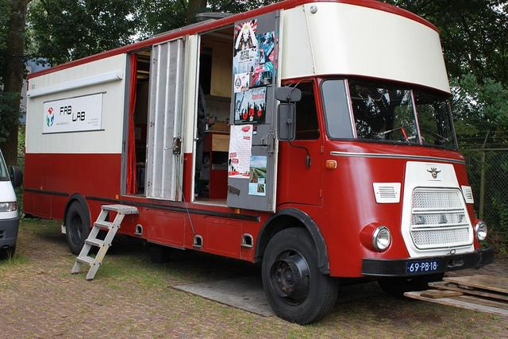
FabLab

Slide 21
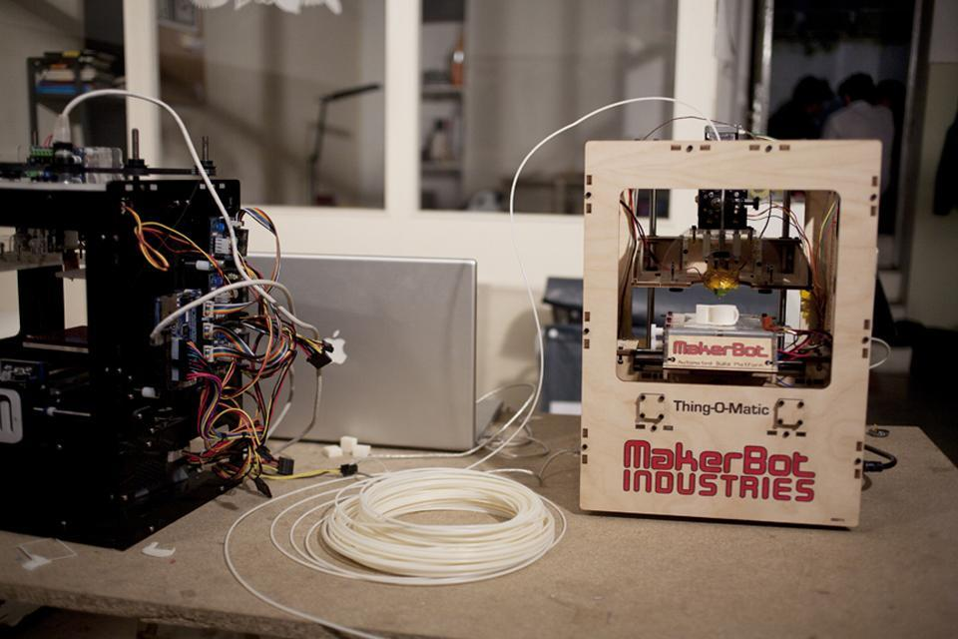
3D Printers - Maker Magazine MakerBot

Slide 22
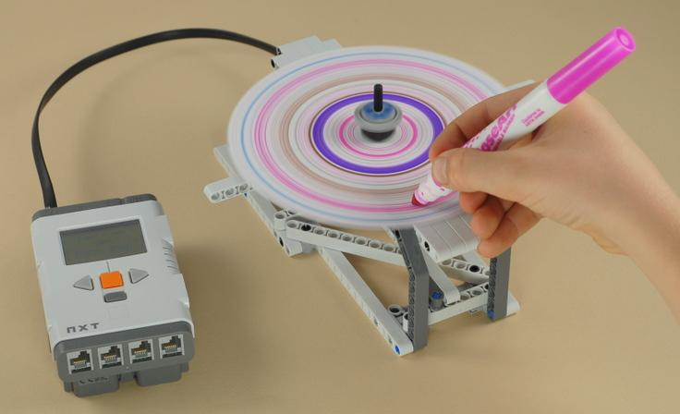
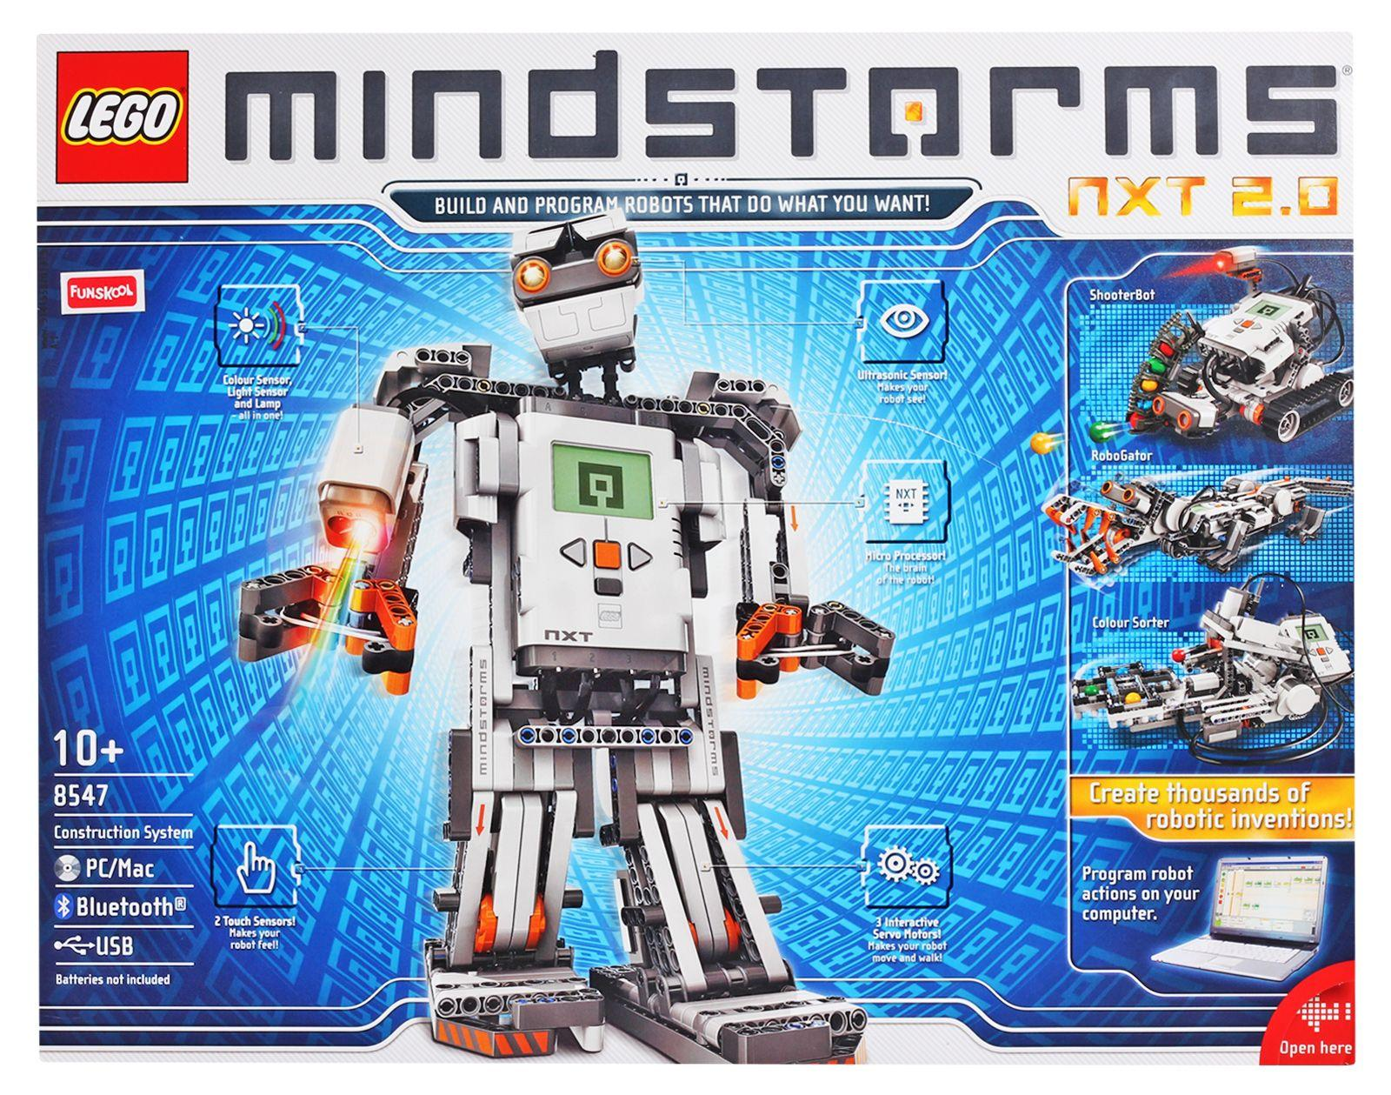
Lego Mindstorms

Slide 23
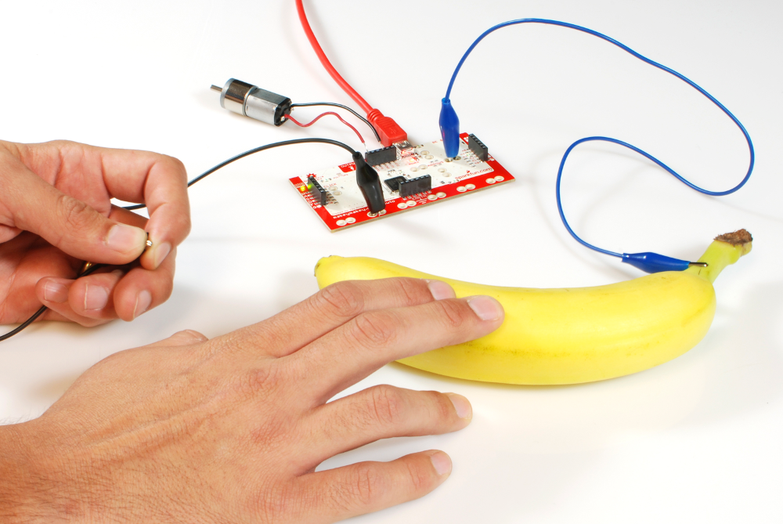
Makey Makey
(Arduino)

