Slide 1
Interfaces & Platforms
Pratt Institute | Teaching and Technology

Slide 2
Learning Management Systems
Course management, mobile learning, communication platform
EdModo
Wikispaces
Weebly
Moodle
Schoology

Slide 3
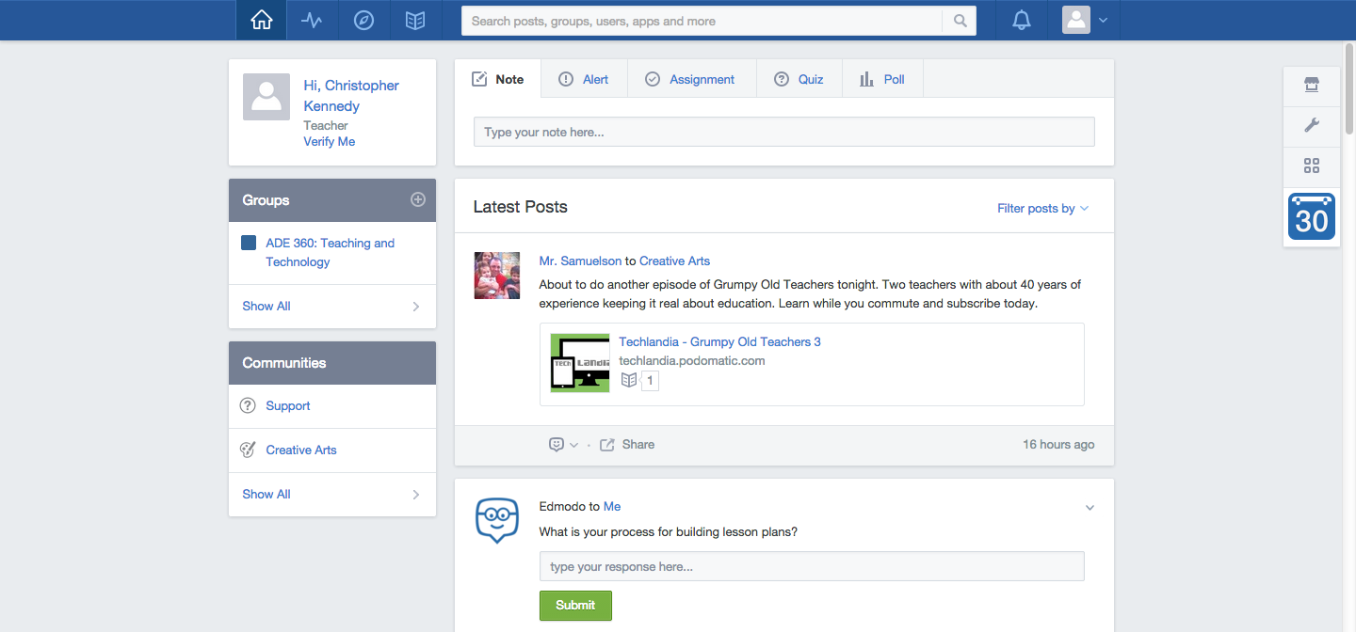

Slide 4
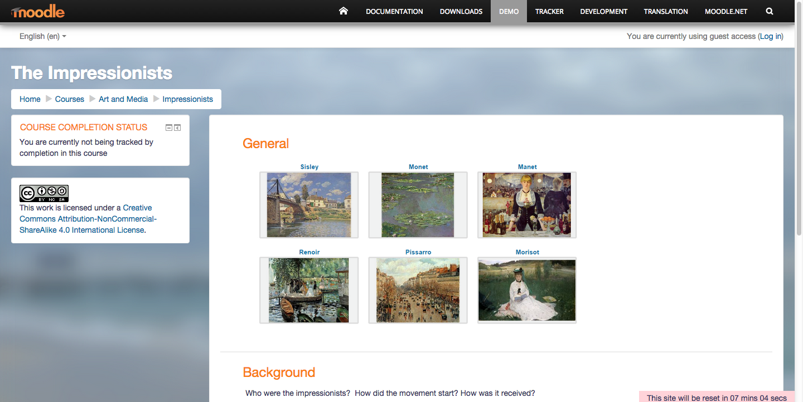

Slide 5
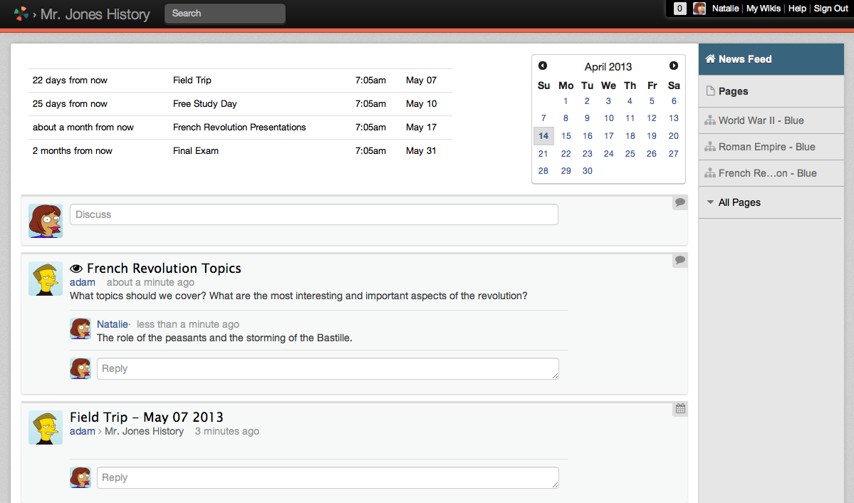

Slide 6
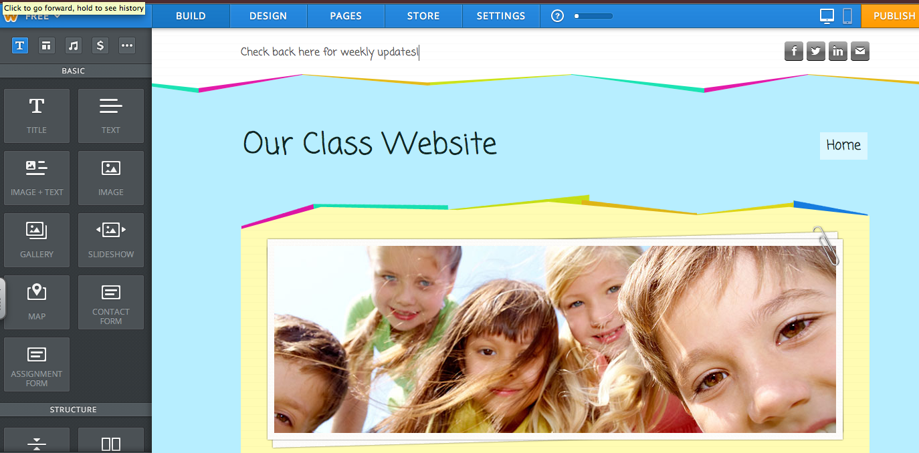

Slide 7
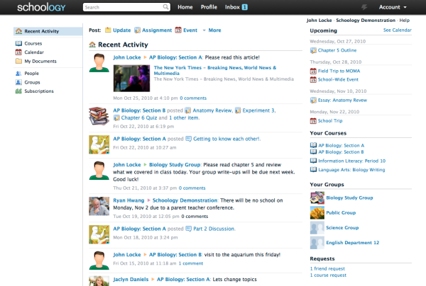

Slide 8
Social/Collaborative Learning
Digital Youth Network
xDiscovery
Playforce
Zaption
Social Media: Tumblr/FB/Twitter

Slide 9
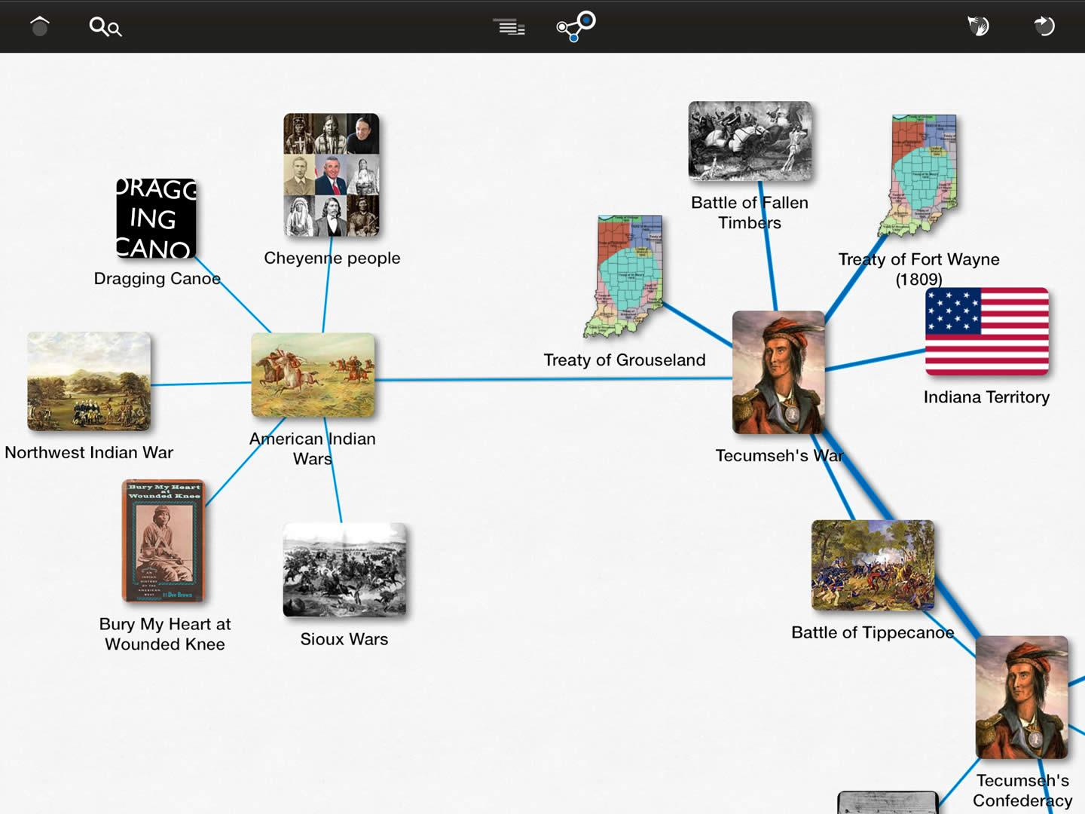
http://learn.xdiscovery.com/#Map

Slide 10
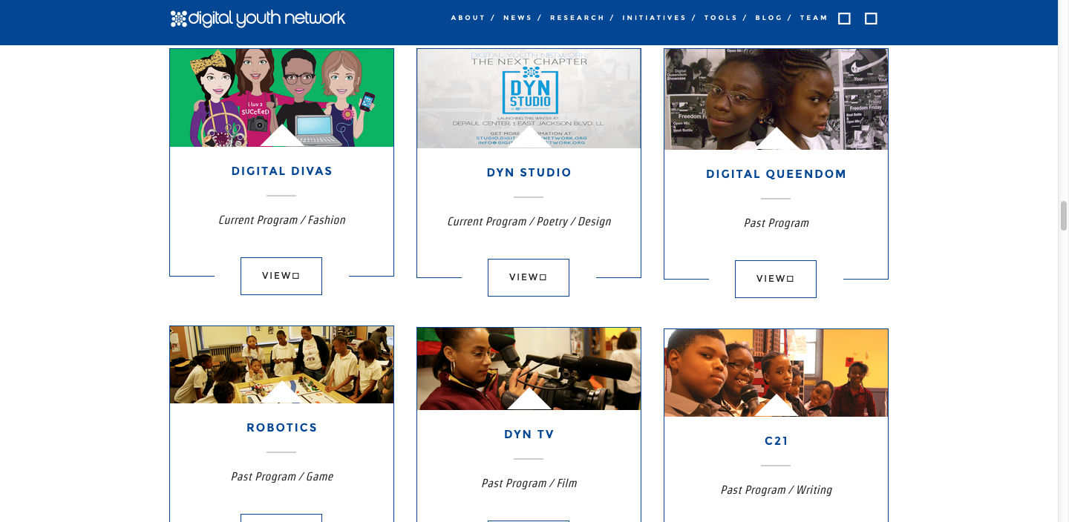
http://www.digitalyouthnetwork.org/

Slide 11
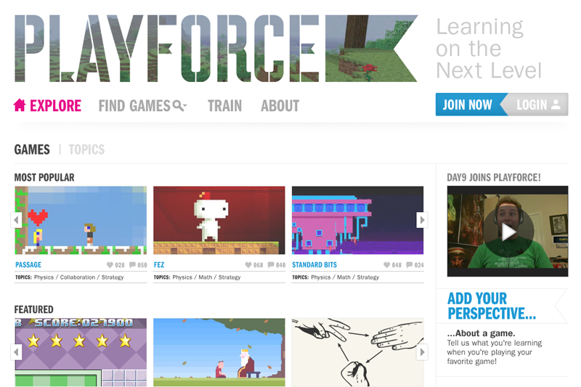
http://beta.playforce.org/

Slide 12
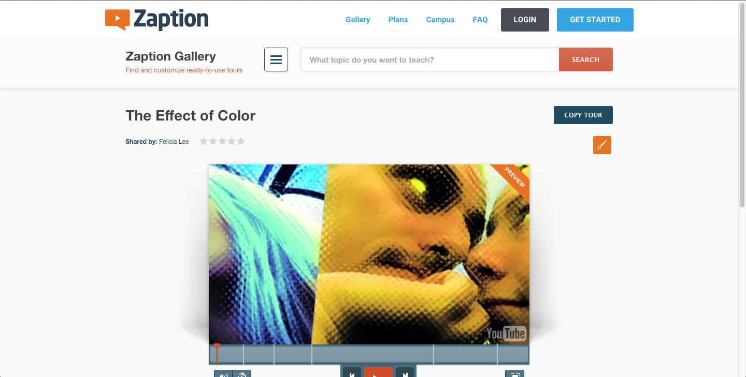
https://www.zaption.com

Slide 13
Assistive Technologies
Computers
SMARTBoards
Tablets
Media Apps

Slide 14
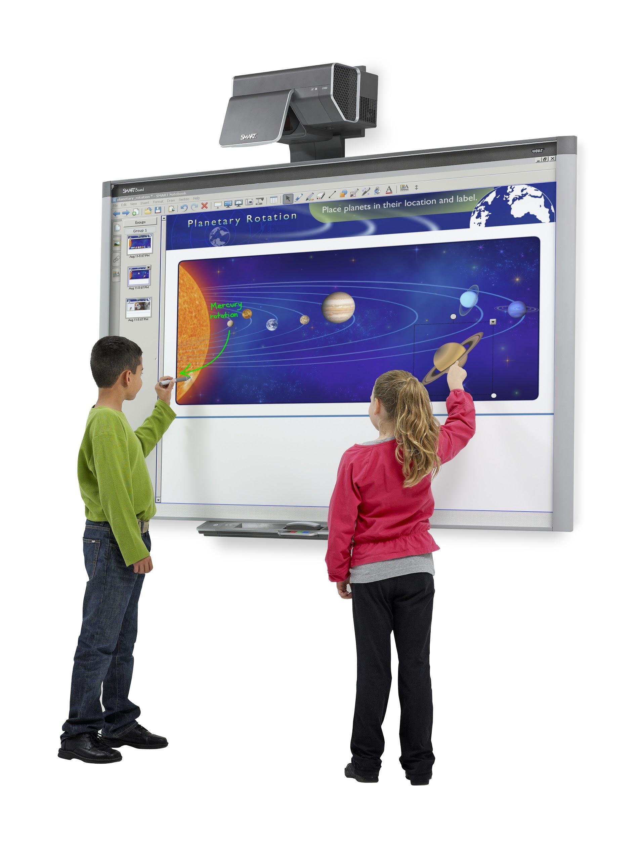
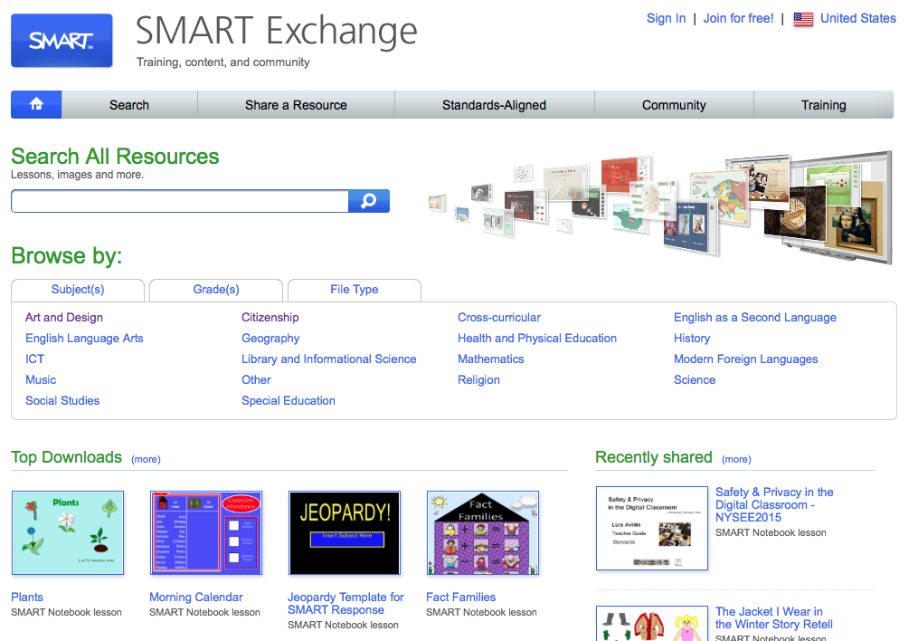

Slide 15
Online Learning Resources
Museums: New Museum, MoMA, Cooper-Hewitt etc.
Curriculum Exchanges: Curriki, OER Commons
DIY Project Ideas: Instructables
Organizations: Smithsonian, PBS, Kennedy Center ArtsEdge, Khan Academy

Slide 16
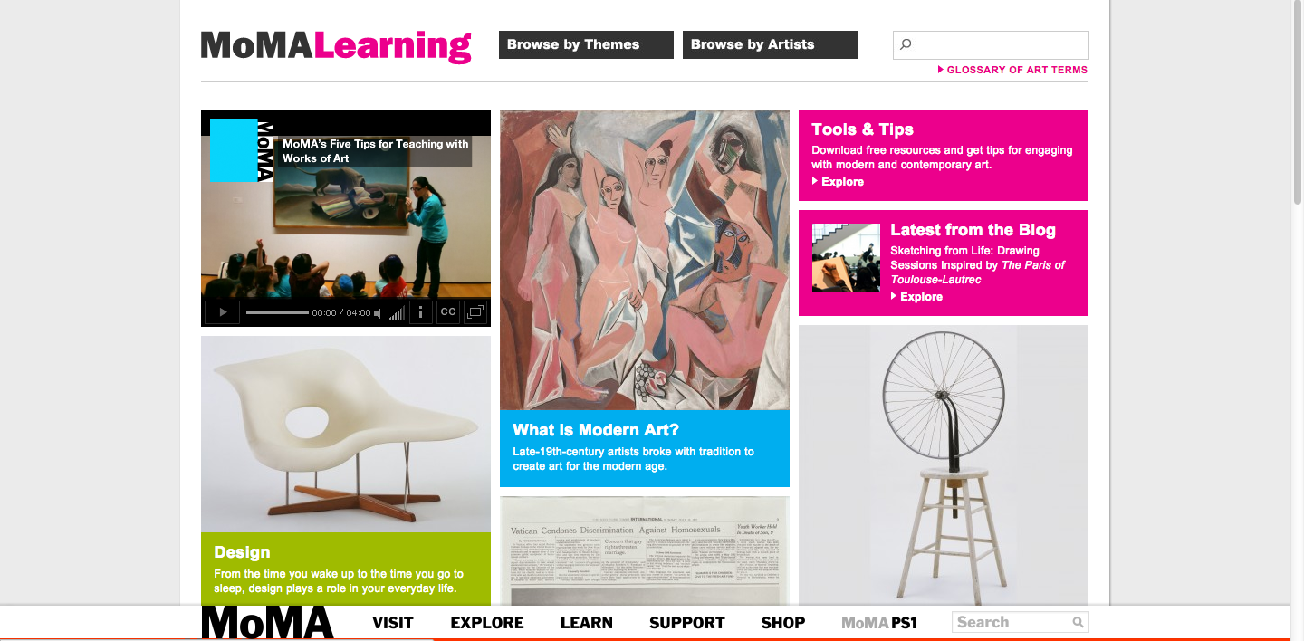
http://www.moma.org/learn/moma_learning

Slide 17
http://dx.cooperhewitt.org/lesson-plans/

Slide 18
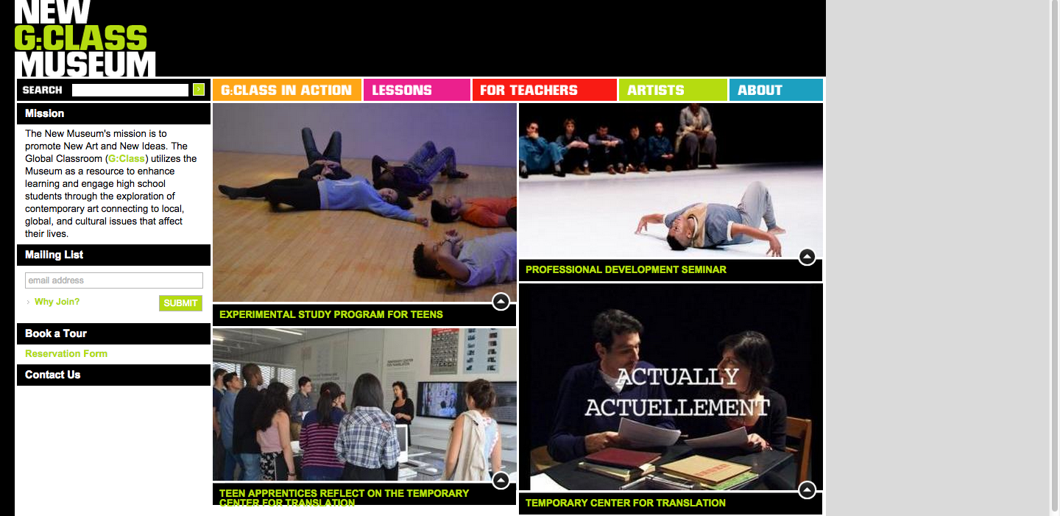
http://www.gclass.org/

Slide 19
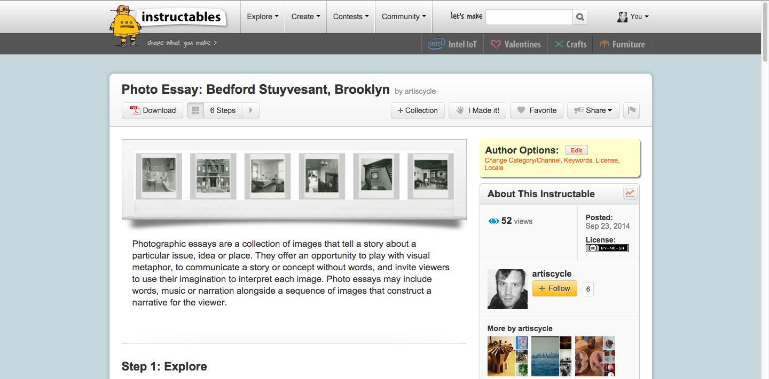
http://www.instructables.com/group/prattade

Slide 20
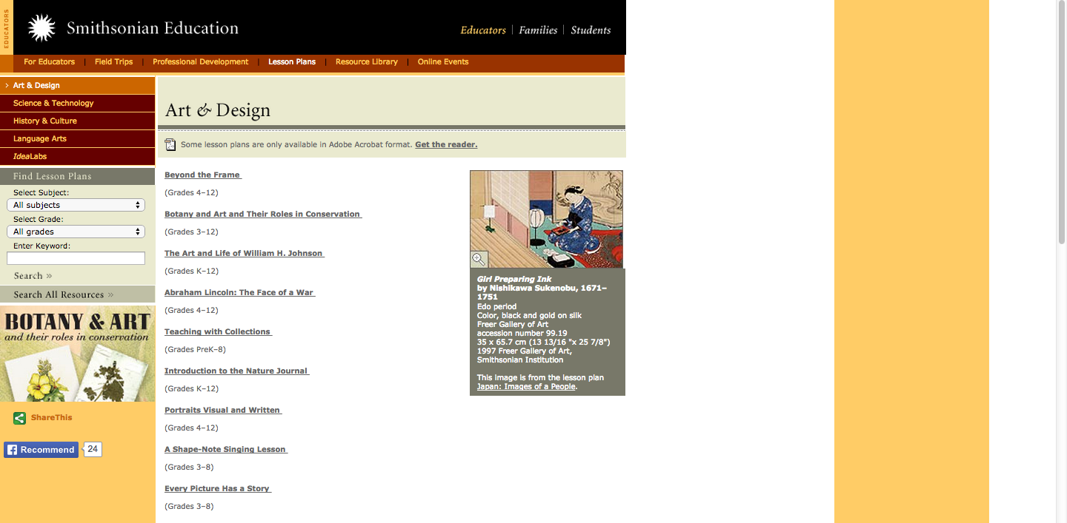
http://www.smithsonianeducation.org/educators/lesson_plans/art_design.html

Slide 21
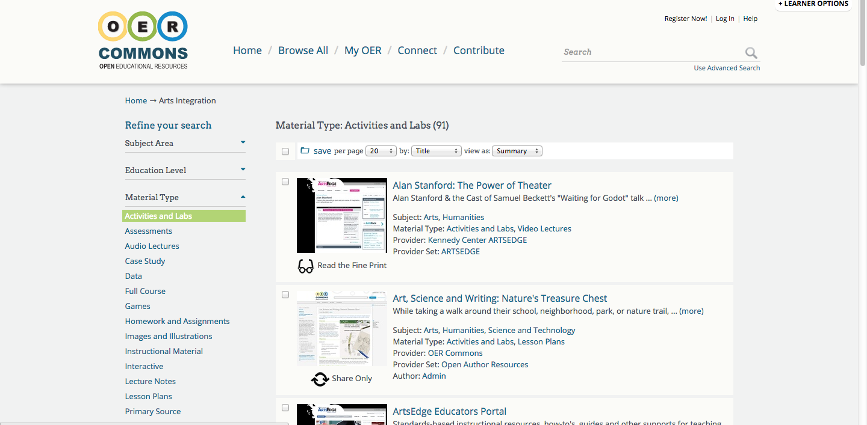
https://www.oercommons.org/arts-integration/material-type/activities-and-labs/

Slide 22
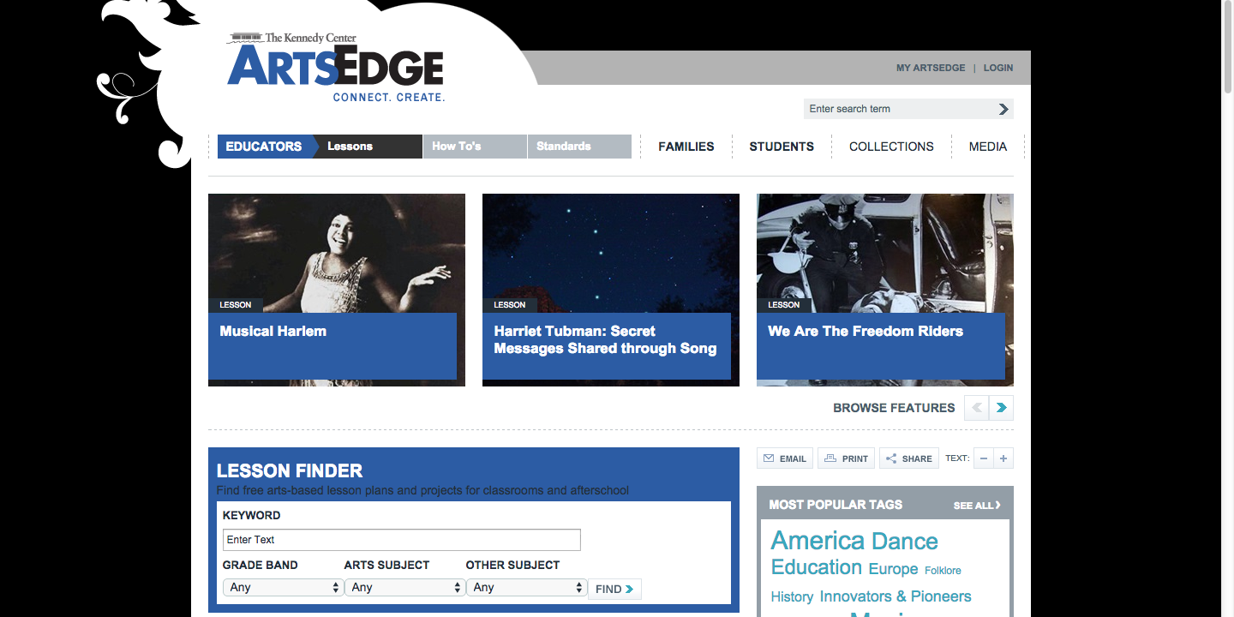
https://artsedge.kennedy-center.org/educators/lessons

Slide 23
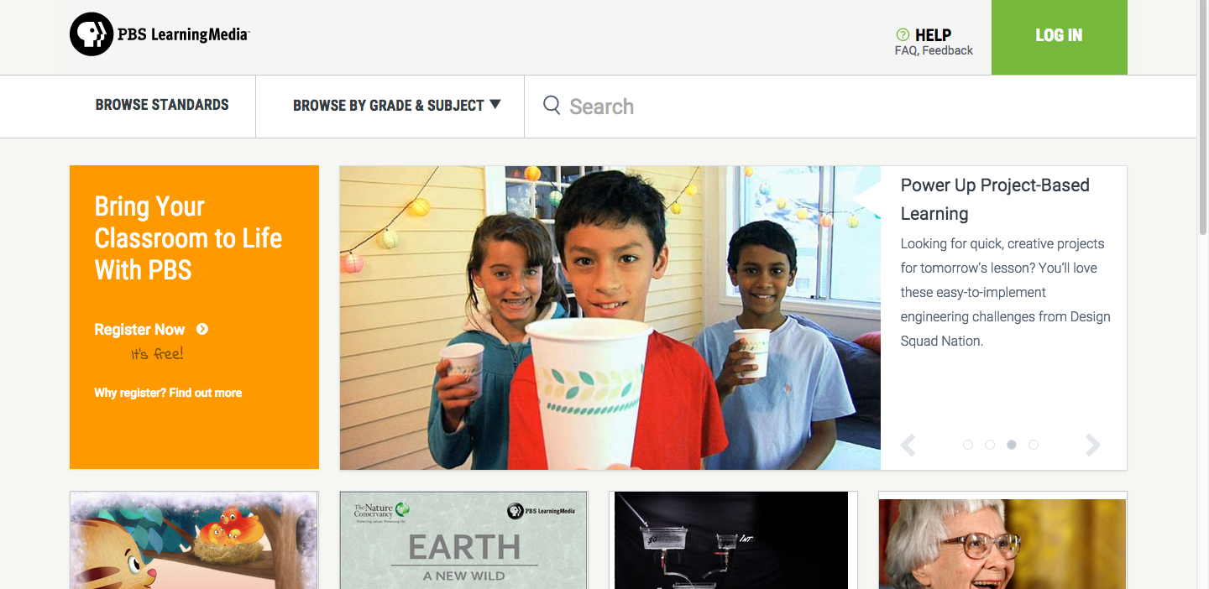
http://www.pbslearningmedia.org/

Slide 24
https://www.khanacademy.org/humanities/art-history-basics/Art-1010/v/contemporary-art-intro

Slide 25
Digital Museums & Archives
Metropolitan Museum of Art
Guggenheim
FIT Museum
Rhizome
Google Cultural Institute
Brooklyn Museum

Slide 26
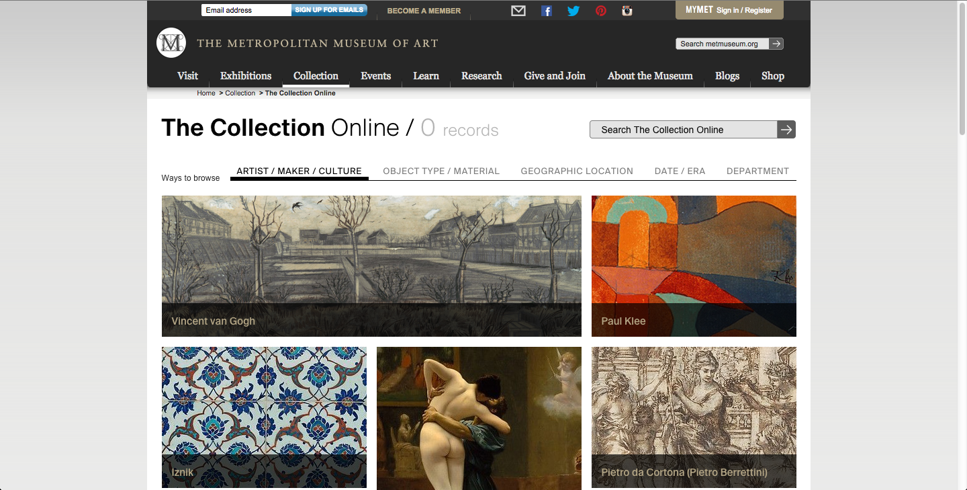
http://www.metmuseum.org/collection/the-collection-online

Slide 27
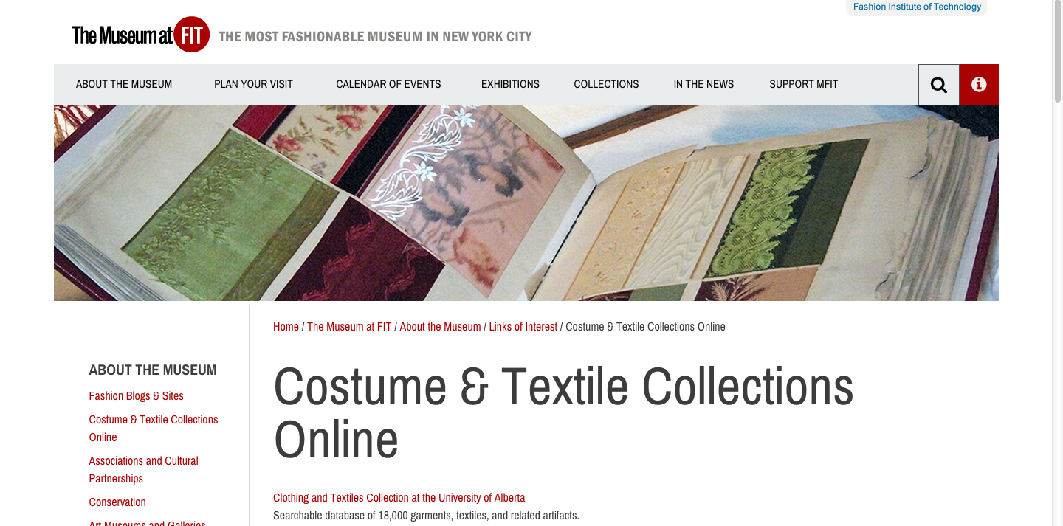
https://fitnyc.edu/3425.asp

Slide 28
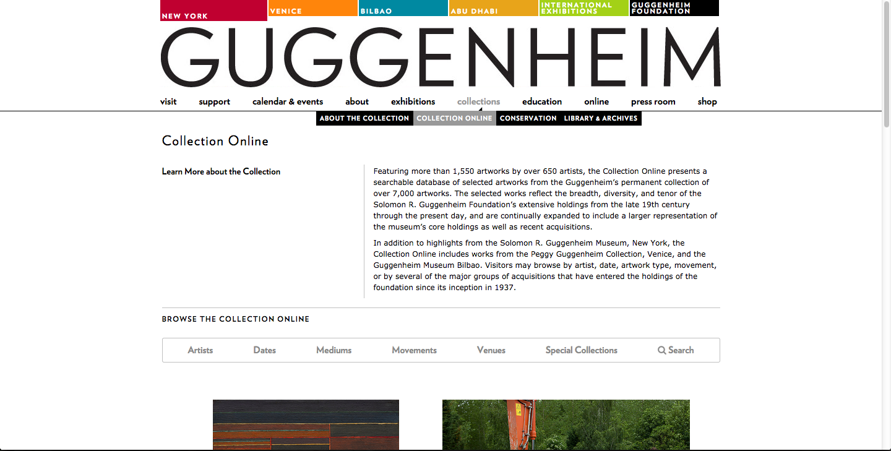
http://www.guggenheim.org/new-york/collections/collection-online

Slide 29
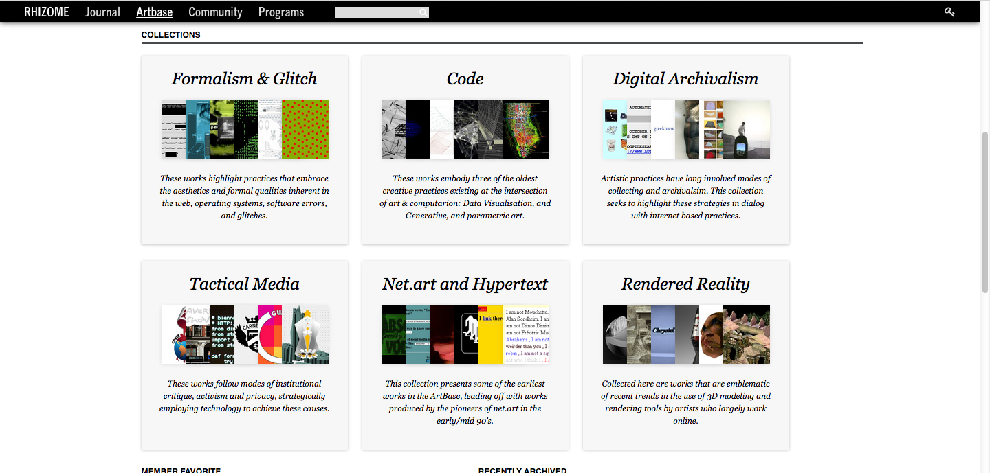
http://rhizome.org/

Slide 30
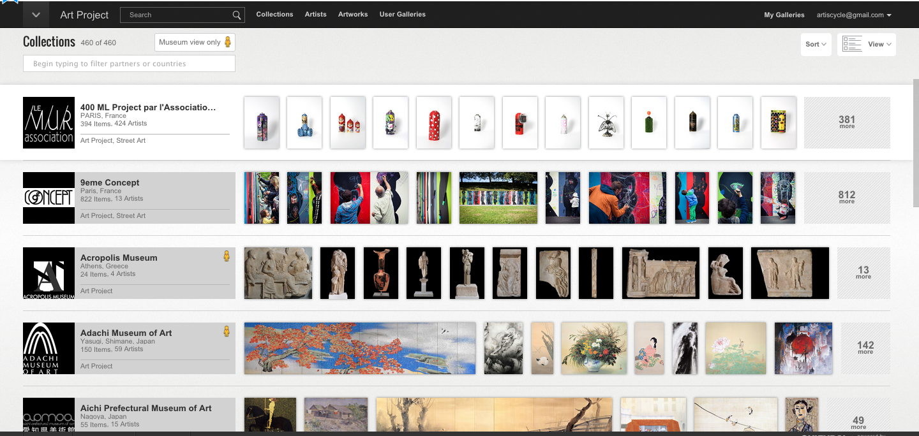
https://www.google.com/culturalinstitute/u/0/collections?projectId=art-project

Slide 31
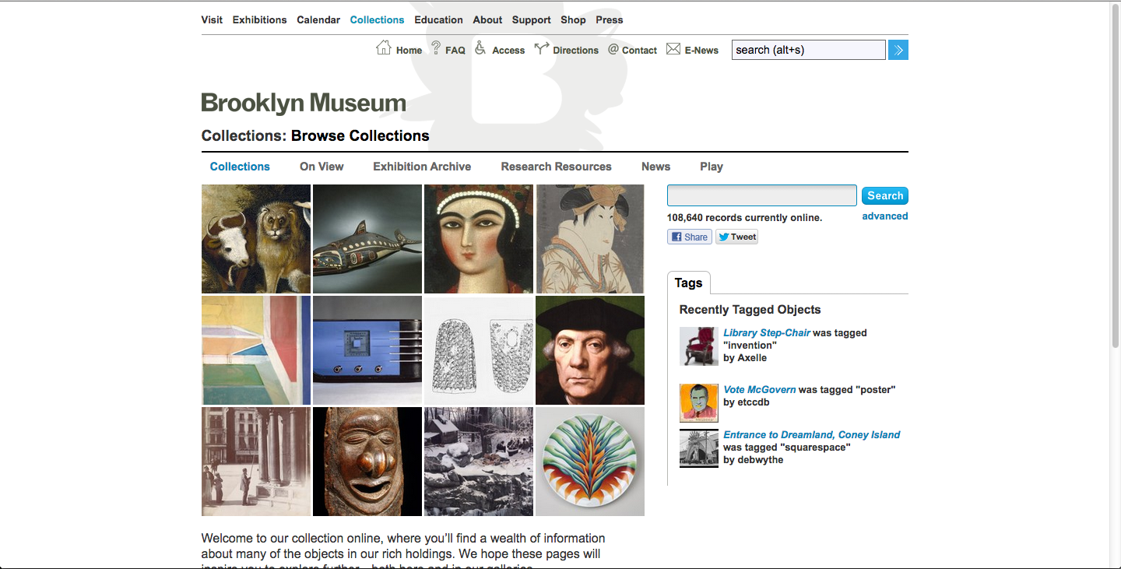
http://www.brooklynmuseum.org/opencollection/collections/

Slide 32
Activity: Digital Art Experiments
Step 1: Experiment with one or more
Bomomo : abstract art generator
The Endless Mural : Amazing 3D abstract art
Picassohead : create art in style of Picasso
Online SVG editor : A vector graphics tool
Pixlr - online photo editor
Sketchpad : a nice sketching tool

Slide 33
Activity: Digital Art Experiments
Step Two: Save your artwork (screenshot) and post to the Tumblr site: adepratt.tumblr.com
Step Three: Use your artwork to create ideas for a lesson plan or learning segment.
Step Four: Upload your project idea and instructions to Instructables.com, share with Pratt ADE group.

