Slide 1
Experiments in Photography & Painting
Media + Materials | Fall 2014
Pratt Institute

Slide 2
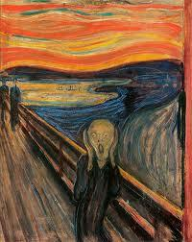
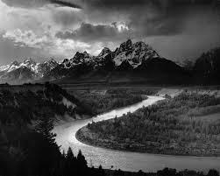
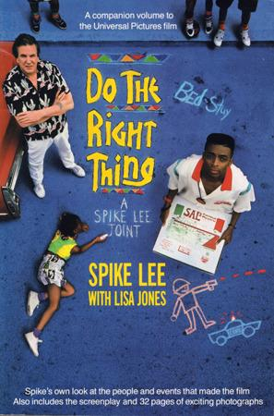
Visual Culture
PAINTING
PHOTOGRAPHY
FILM
Edvard Munch
Ansel Adams
Spike Lee

Slide 3
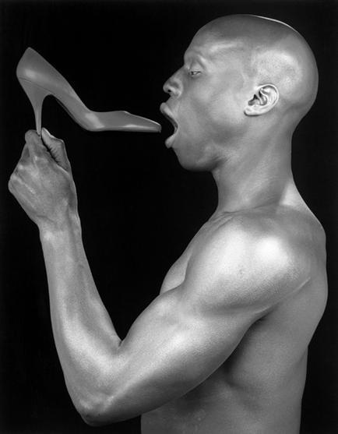
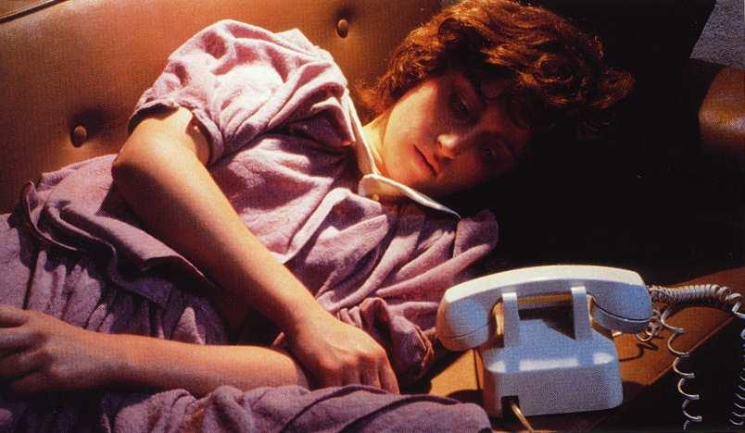
Image, Symbol, Myth
Looking for meaning
Creative Storytelling
Imaginative Play
Composition and Form
Robert Mapplethorpe
Cindy Sherman

Slide 4
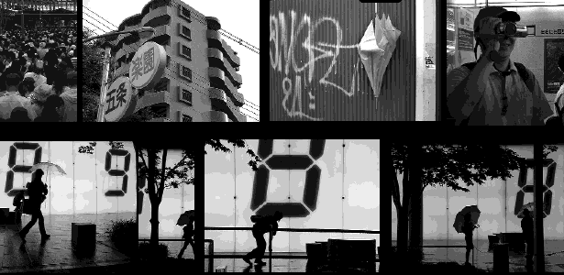
Photographic Essay
Drury Brennan, Japan, 2005
NY Times | Photoessay | Mother Jones

Slide 5
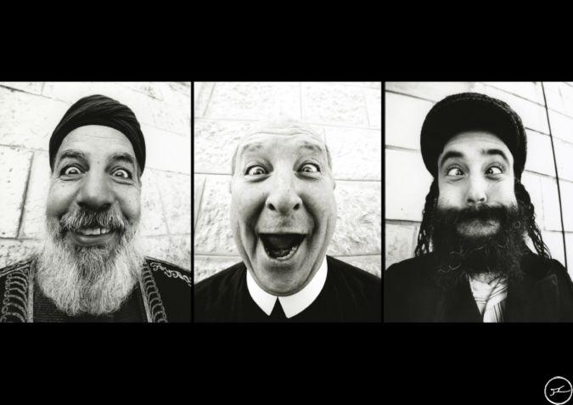
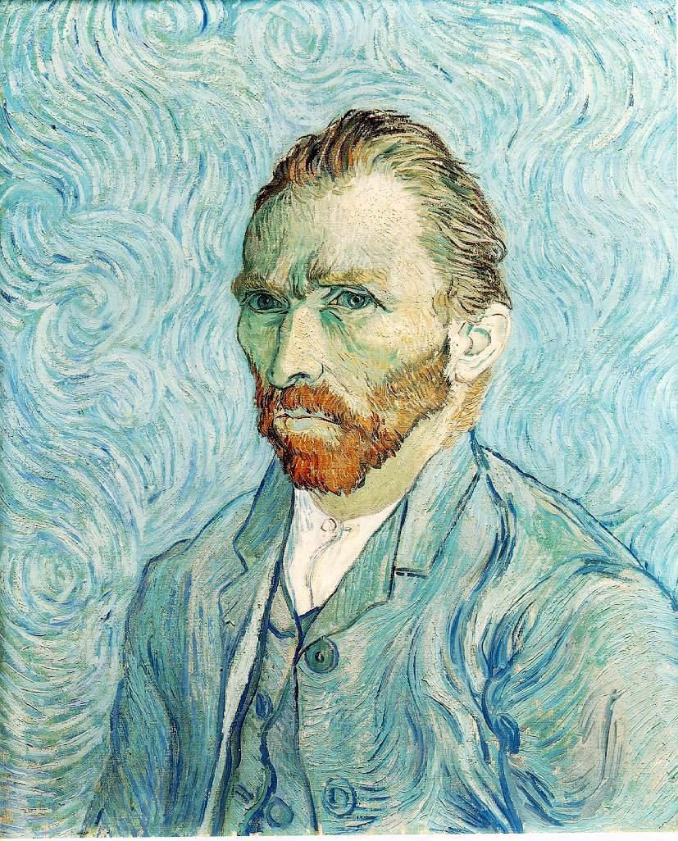
Portraiture
JR, 2007, Face to Face
Van Gogh, Self-Portrait 1889

Slide 6
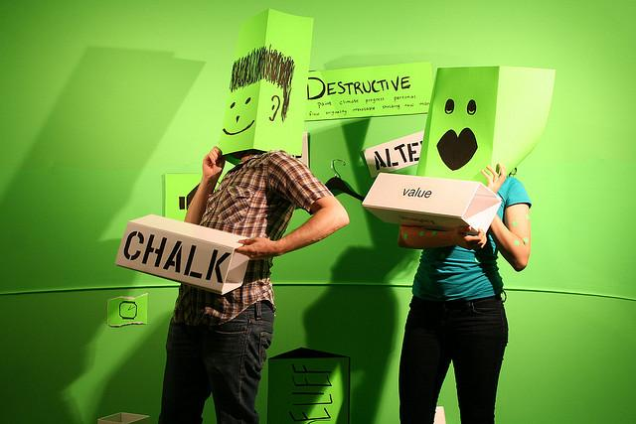

Slide 7
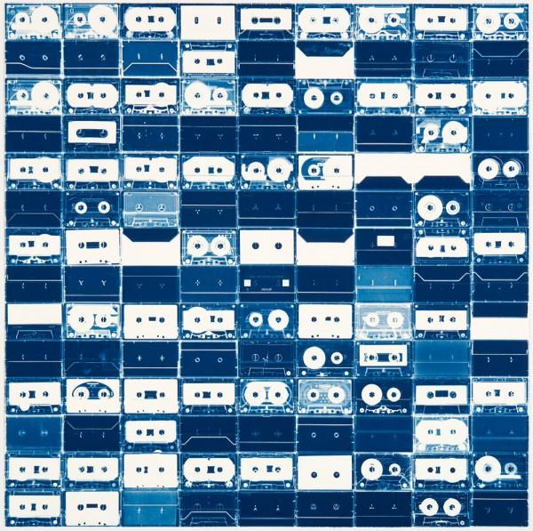
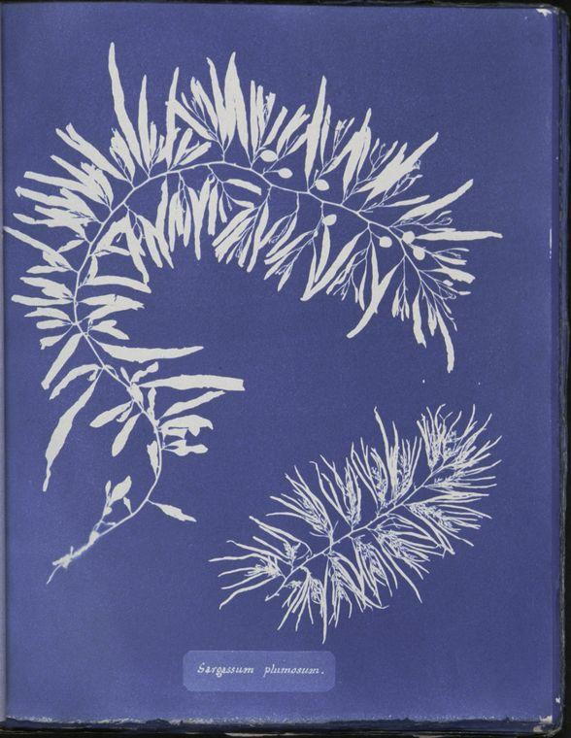
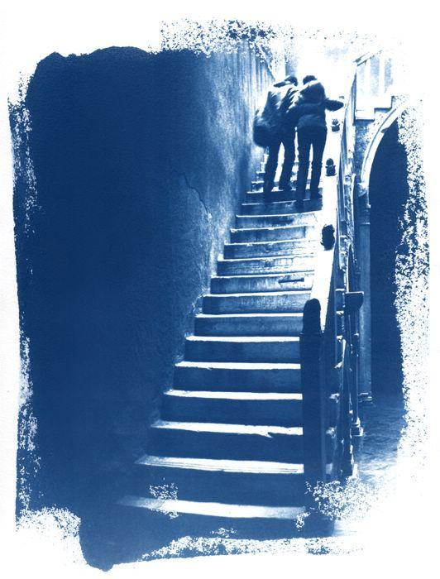
Cyanotypes
Michael Herin
LUMI
Christian Marclay
NYPL Archive

Slide 8
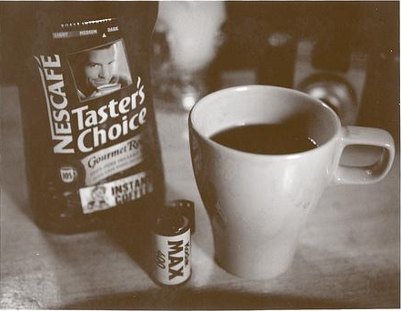
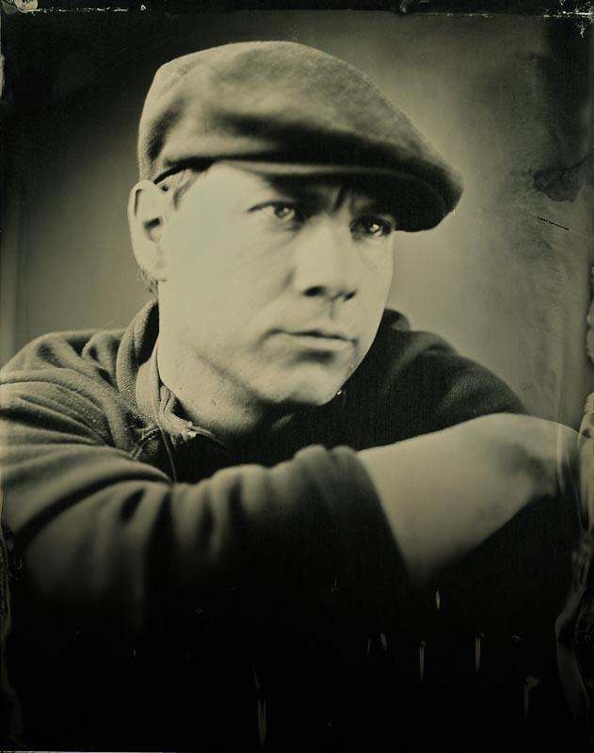
Caffenol Development
Gabriel Van Ingen

Slide 9
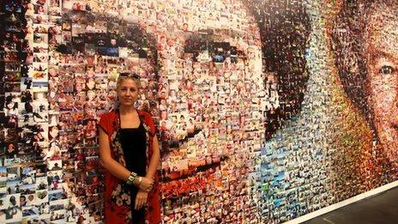
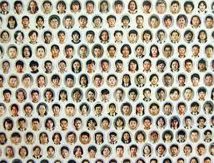
Photo Mosaic
Helen Marshall
Mazaika
http://www.macosaix.net/
Do Ho Suh

Slide 10
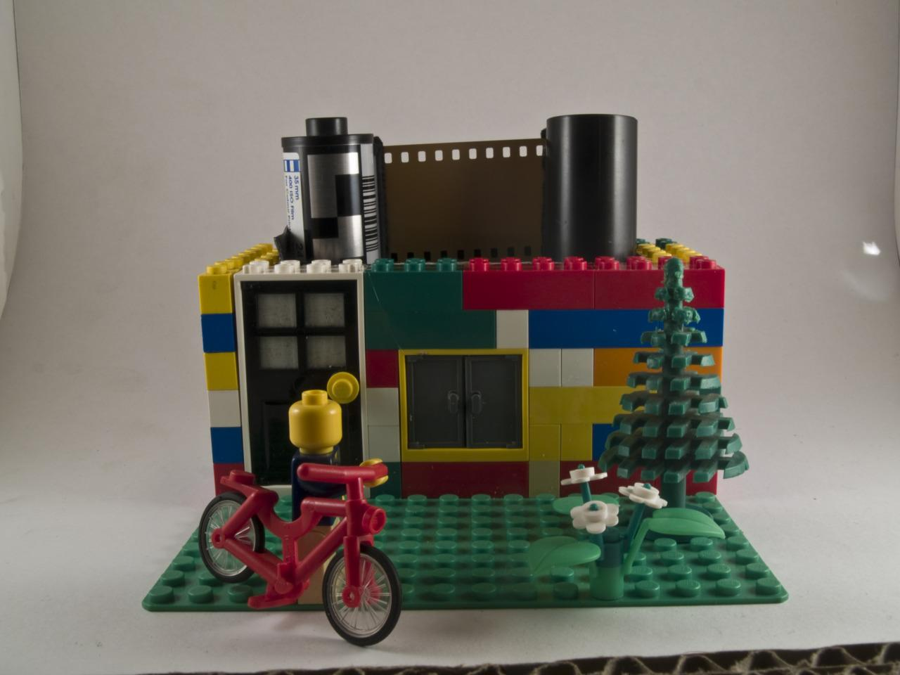
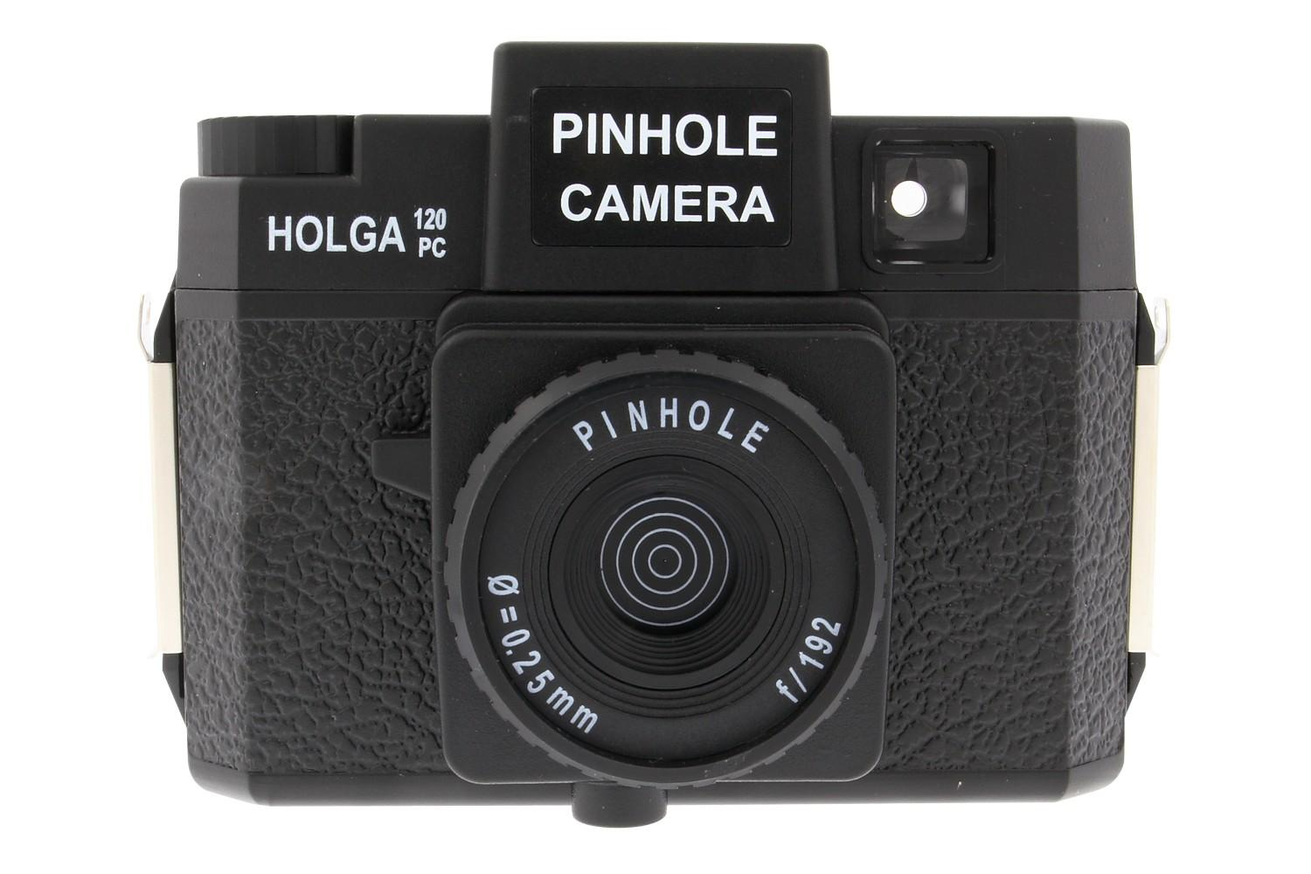
Pinhole Cameras
Peter Maarseveen

Slide 11
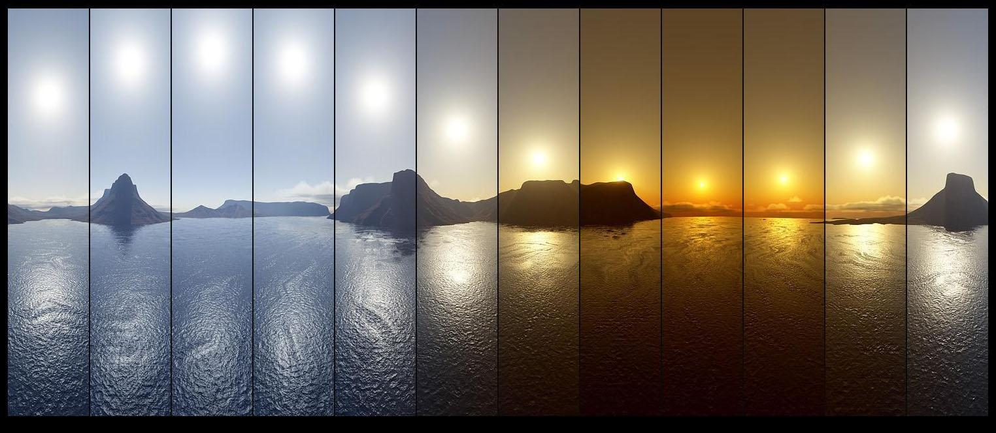
Time Lapse & Light Experiments
Lincoln Harris

Slide 12
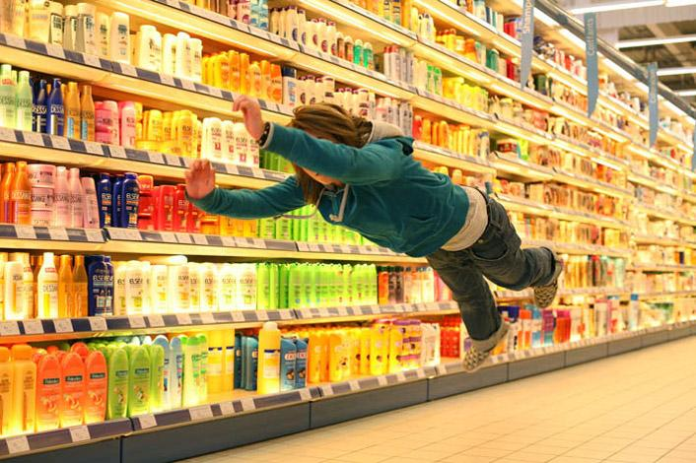
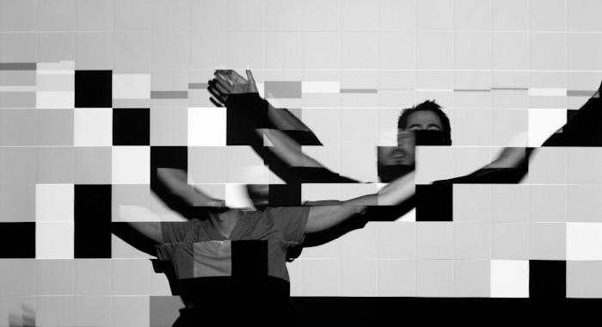
Digital Applications: Photoshop
Ishac Bertran
Denis Darzacq

Slide 13
Silouhettes
Kara Walker, 1995, The Means to an End: A Shadow Drama in Five Acts

Slide 14
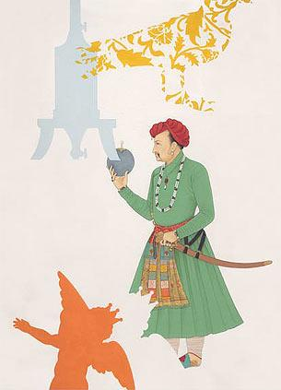
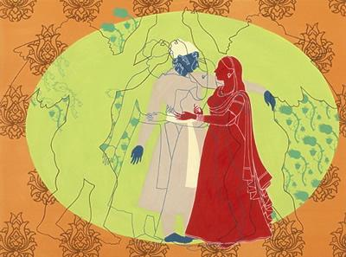
Collage & Painting
Nusra Latif Qureshi

