Slide 1
Realism

Slide 2
Realism
“It is the perception of a concrete fact or knowledge of the term that signifies that fact” (hummel, 1993, p. 8-9).

Slide 3
Realism?
Reality = independent from mind
Understand objective reality with concrete facts and scientific data

Slide 4
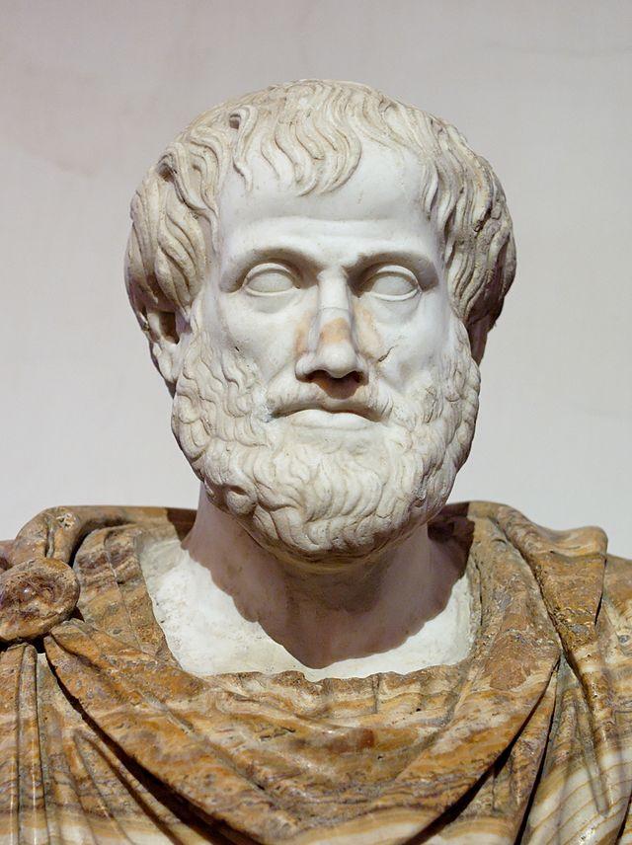
Aristotle
384-322 B.C
Age 18 – entered plato’s academy
Athens – assos - mytilini
Biology research
Tutored young alexander
334- Returned to athens – Lyceum
Public/open university
Democratization of education

Slide 5
Goal of education
“Education is essential for the complete self-realization of man” (Hummel, 1993, p.2)
Supreme good = happiness
Happiness = educated man
The nichomachean Ethics
Virtue: intellectual and moral
The “good” and “virtuous” man
Nature
Habit
Rationality

Slide 6
Goal of education
Ethics: happiness, the mean, leisure and wisdom
Goal of human action = leisure = “schole” (school)
Being able and knowing how to use one’s time freely
Freedom: the mind relieved of all material constraints = leads to wisdom

Slide 7
Goal of Education
“Good” – found in the laws of nature & order of the physical world
Believe in metaphysics
Teach the truth and understand the present practical life

Slide 8
Education system
Education = responsibility of the state
Continuing education
“Education must be one and the same for all” (hummel, 1993, p. 5).
Developmental stage (schooling, age, intellectual ability and level)
Educational city “polis”
Democratization of education – limits?
Working class
Women not equal to men

Slide 9
Education system
Grammar, physical training, music, drawing
Teaching of sciences
Physical training = help to form “character”—courage, sense of honour
music = moral character and aesthetics; “cultivation of the mind,” “pleasure”

Slide 10
Pedagogy
Taking into account the intellectual ability/level in teaching and learning (age, character…)
Stages
Education
Reason: scientific approach, theoretical philosophy; the universal
“To teach is to indicate the causes of all things” (Hummel, 1993, p.8)
Habit: “active learning” –we learn by doing them –imitation, experience and memory
Governed by pleasure AND pain

Slide 11
Pedagogy
Language: “essential instrument of education”
Education through reason:
Induction or epagoge (experiences)
Demonstration

Slide 12
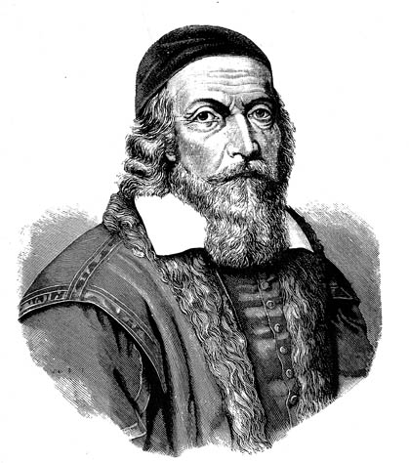
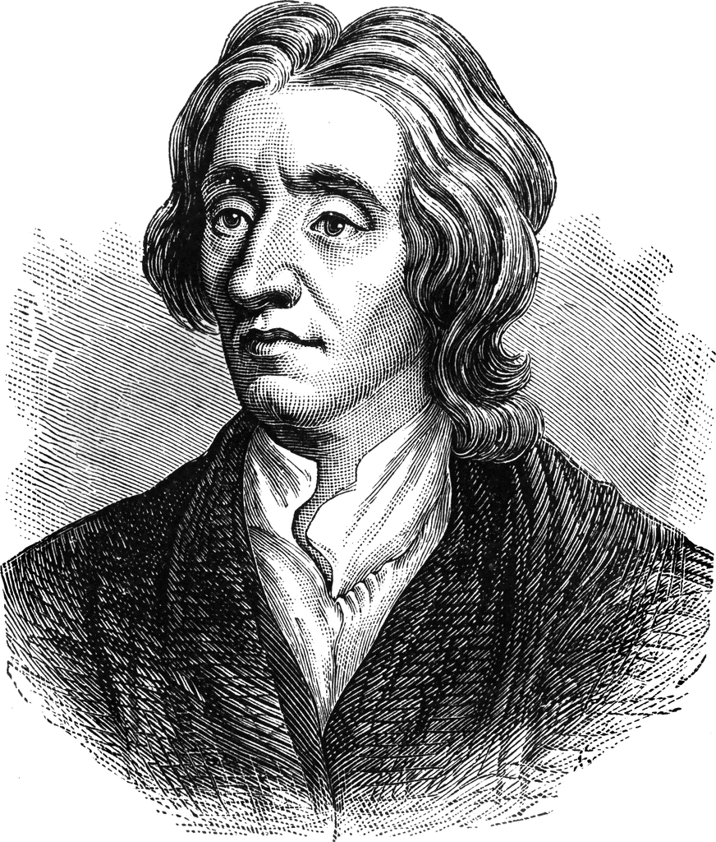
17th-18th Century
John Amos Comenius
Orbius Pictus (1658)
Human mind = mirror
John Locke
“Ideas are not innate but all experience is the result of impressions made on the mind by external objects” (Maheshwari, p. 1).
Tabula rasa = mind as a blank sheet
All ideas come from either sensation or reflection

Slide 13
Epistemology
Object of the external world is presented in consciousness NOT represented
Perception of the object = it is there (no in-between)

Slide 14
Realism & The Child
Broudy Principles:
Appetitive
Self-determination
Self-realization
Self-integration
“Trained” to become a man
Pupil—”machine”

Slide 15
Realism & The Teacher
Teacher = “guide”
Lectures, demos, sensory experiences
Factual presentation
“Master of knowledge”
Strive for mastery of facts and information

Slide 16
Realism & Curriculum
Humanistic Realism—Classical literature—nor for form/style but content/ideas
Sense-realism—study of natural sciences and contemporary life
Neo-realism—physics, humanistic feelings, psychology, sociology, economics, ethics, politics, history, geography, agriculture & varied arts, languages
“The real world” –mathematics*

Slide 17
References
Hummel, Charles. (1993). “Aristotle.” Prospects: the quarterly review of comparative education. UNESCO: International bureau of education.
Maheshwari, V.K. “Realism in Education”

