Slide 1
ROBOTS!
By Shina Yoon

Slide 2
Joel Shapiro
American sculptor
Dynamic, large-scale geometric shape sculptures
Figuration and abstraction
Wood, bronze
Post-minimalist

Slide 3
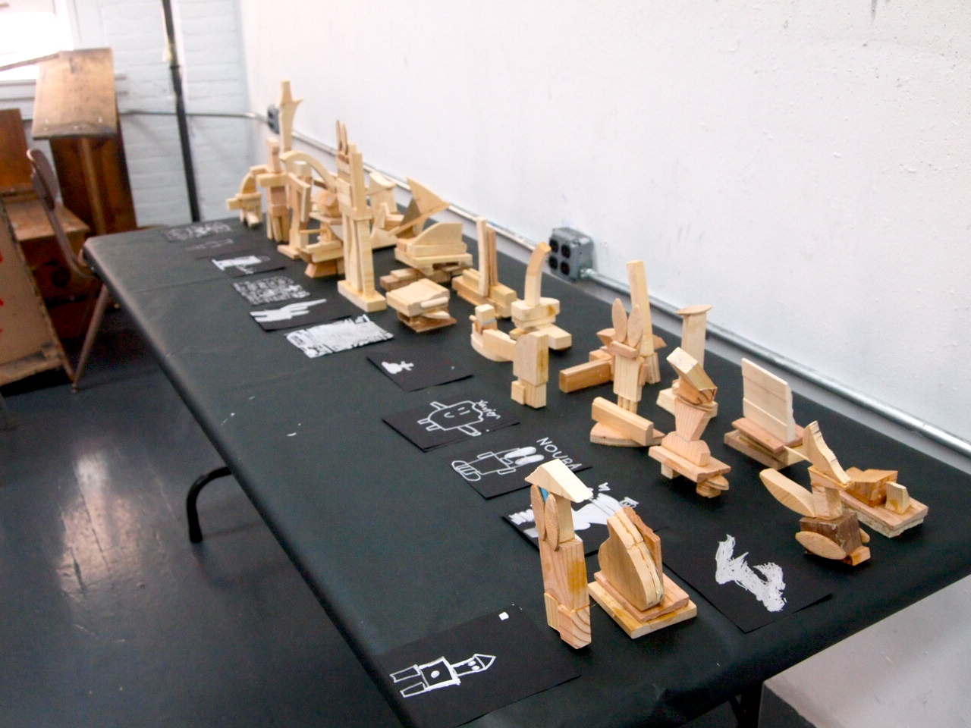
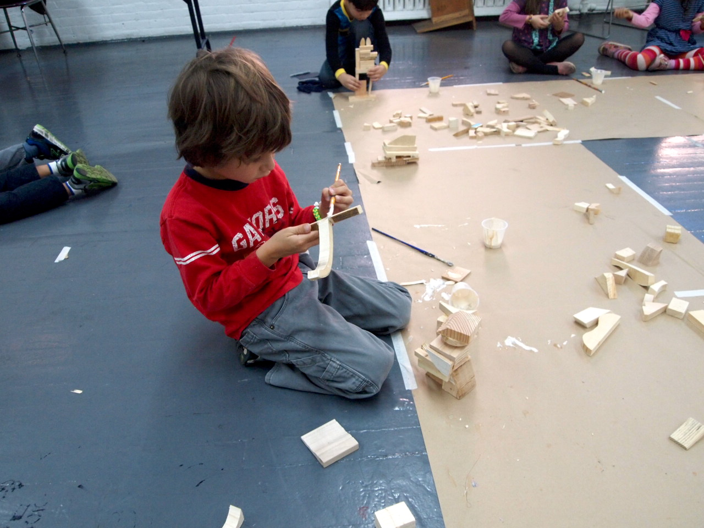
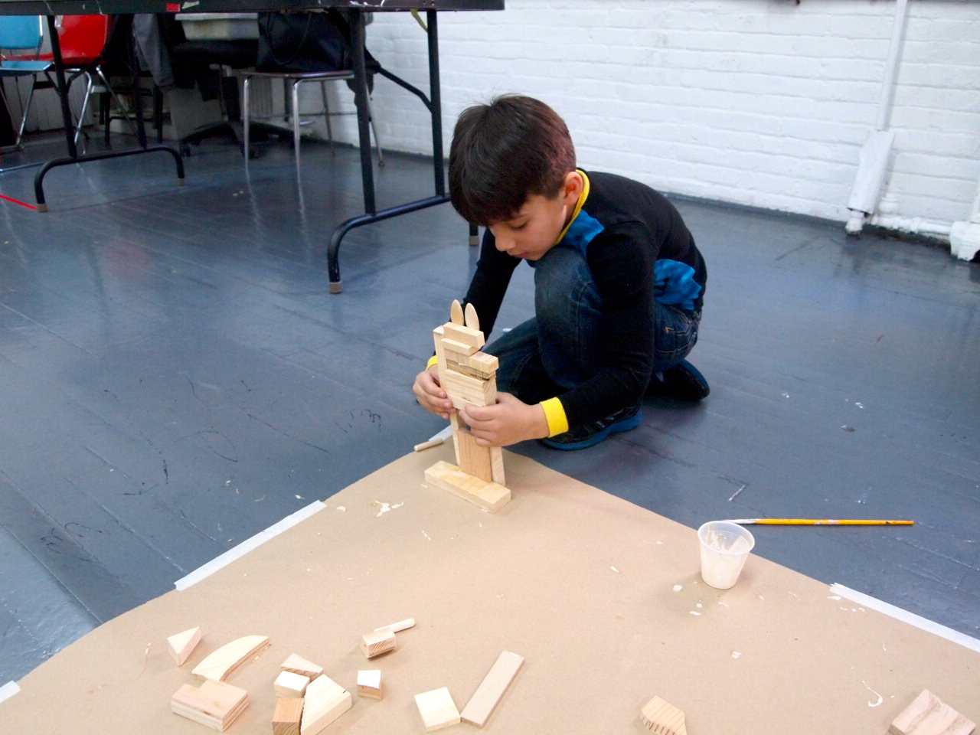
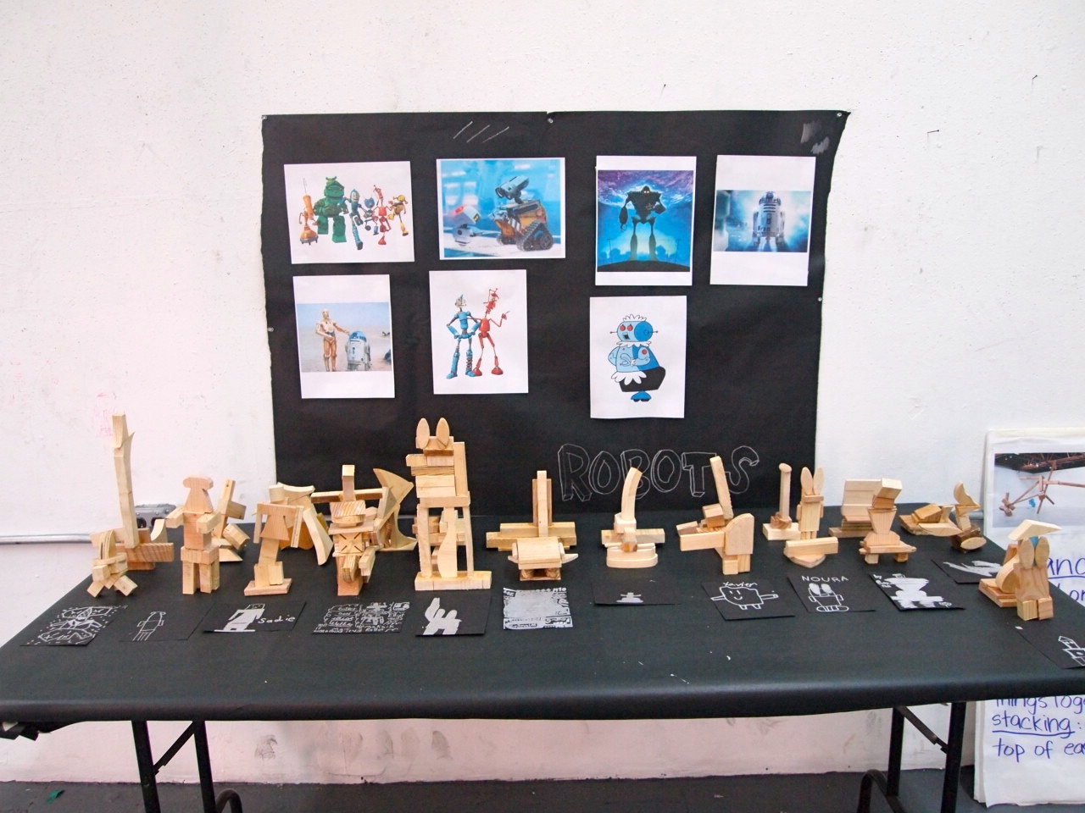

Slide 4
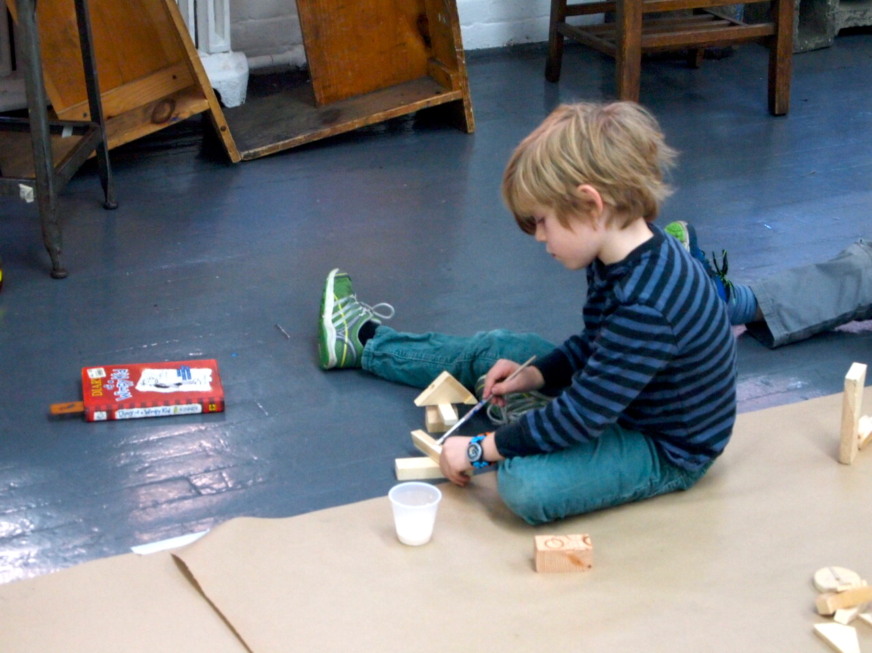
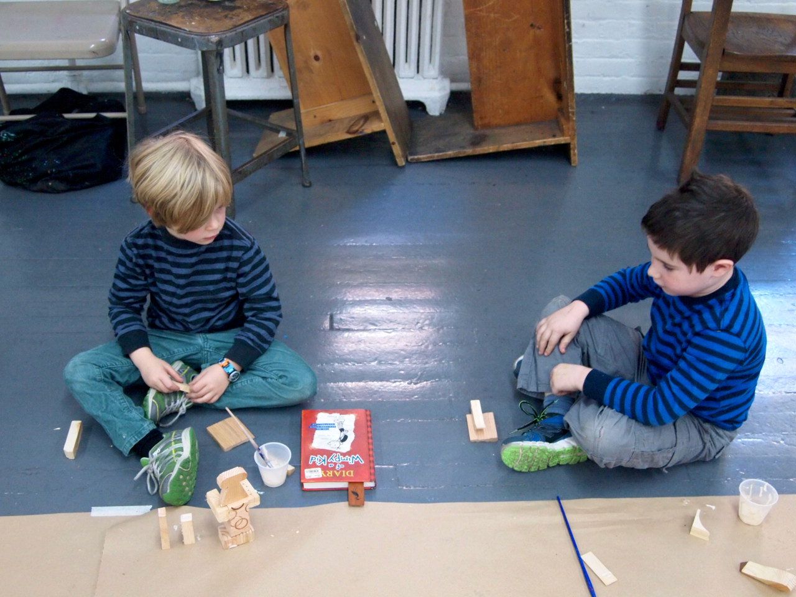
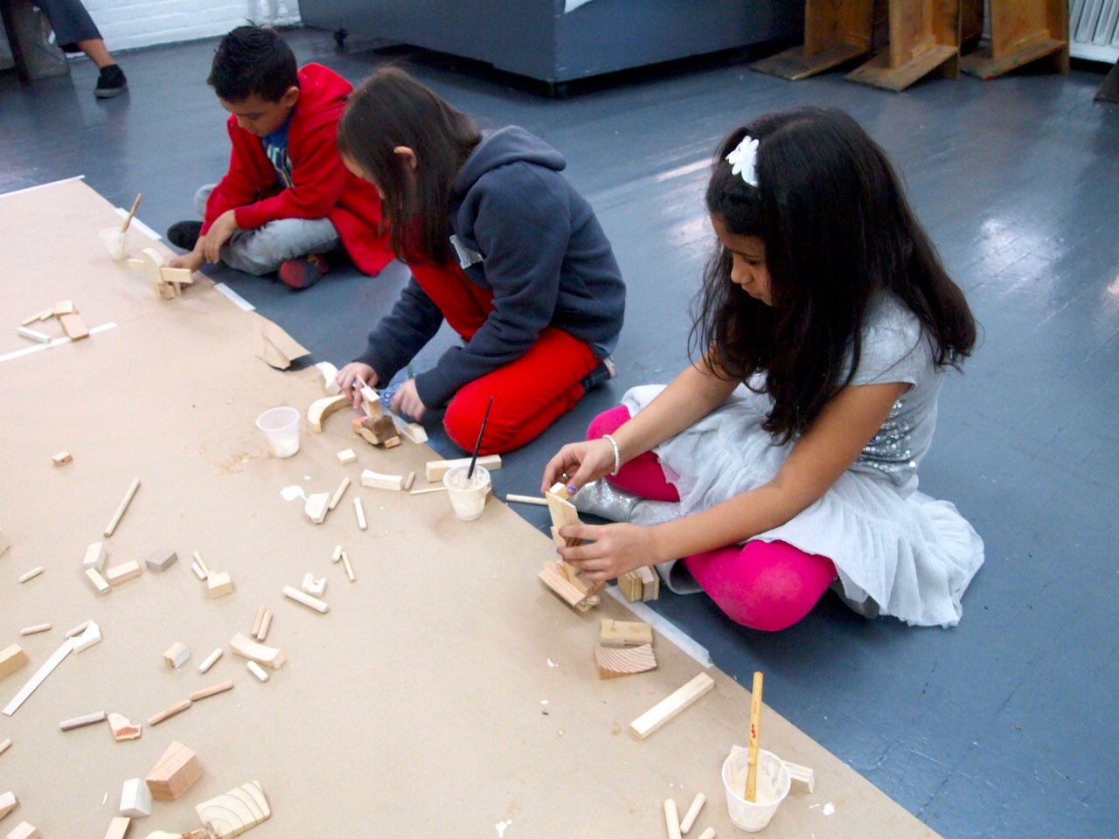
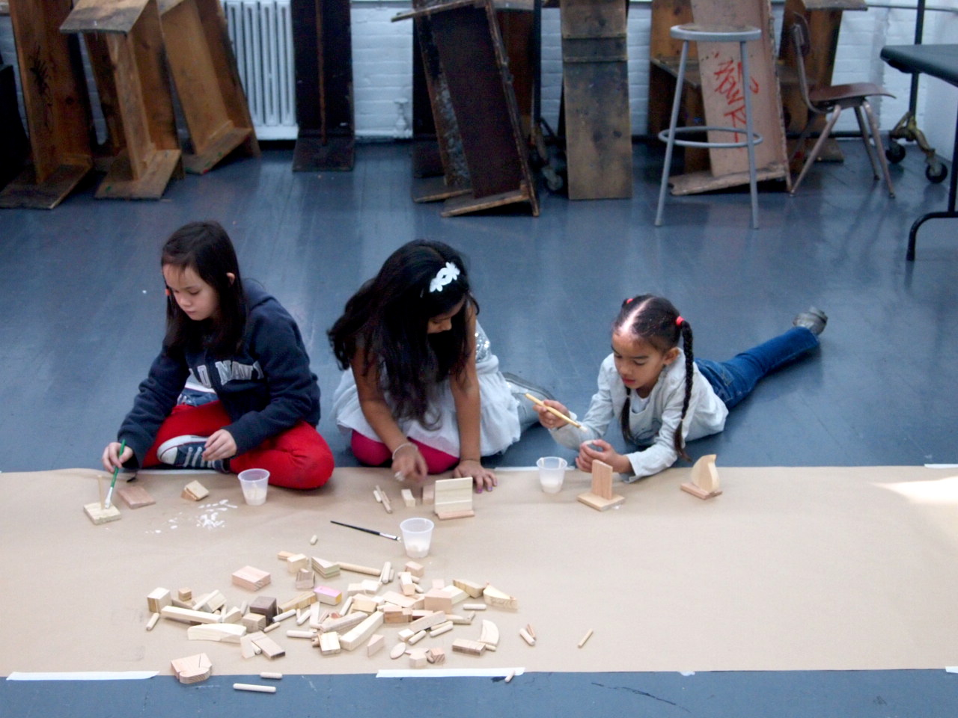

Slide 5
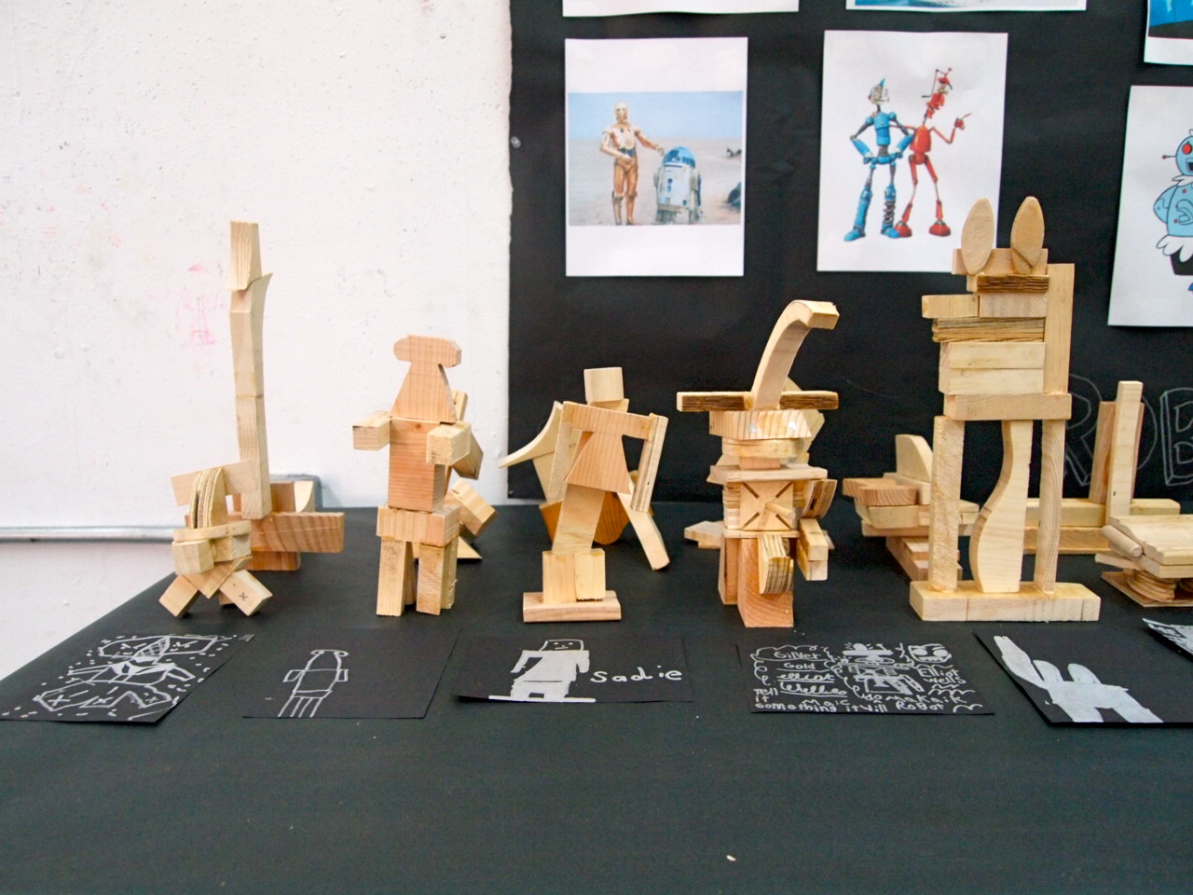
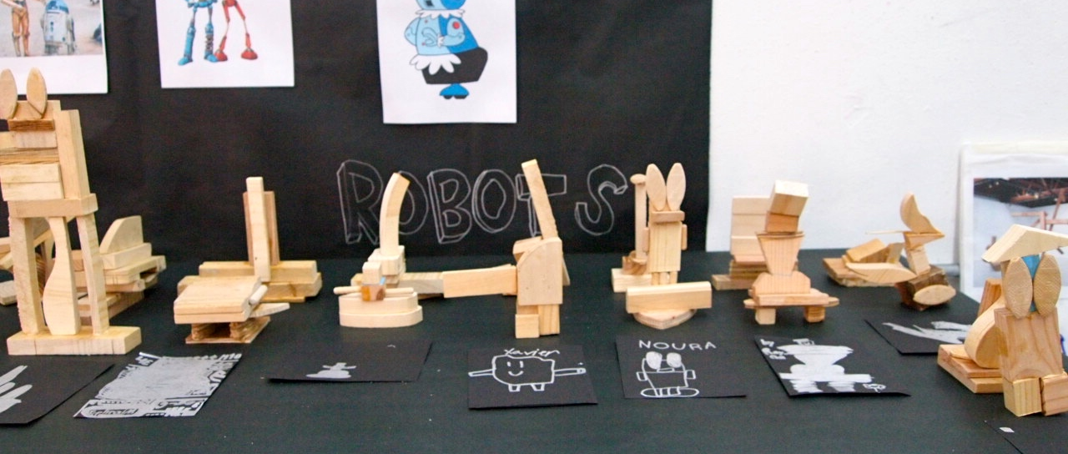

Slide 6
Learning Segment
Lesson 1: What is balance? A lesson on balance and weight distribution looking at Joel Shapiro’s work and build balanced structures
Lesson 2: What kind of robot are you going to build? Conversation on problems they face everyday and the jobs they can give their robot to solve the problems
Lesson 3: Peer assessment and add finishing touches/modifications to their robots.
Lesson 4: Drawing of their robots and a class share

Slide 7
Central Foci
Art Context: Sculpture, wood, robot design, architecture
Form & Structure: Balance, form, shape, scale, proportion
Personal Perspective: Students will build a freestanding sculpture of a robot using wood pieces. Students will engage in a conversation on the problems they face everyday (at home, community, school, classroom…) and the jobs they would give their robots to solve these problems.
Production: Selecting, stacking, adhering (gluing), assembling, supporting, adding, subtracting, balancing

Slide 8
Learning Objectives
Students will be able to…
Select and combine wood pieces/scraps to build a freestanding sculpture
Develop craft: use the glue effectively
Add details to suggest robot being to their sculptures
Connection of form and function
Do a representational drawing (robot drawings)

Slide 9
Learning Goals
Students will understand that…
They can add legs and/or a strong base to balance their sculpture
Glue works effectively when used in moderate amount and holding the pieces together for couple seconds
How different arrangements of wood pieces can balance a structure/make it stand
Variety of sizes and shapes in wood as well as details can suggest robot being/add visual complexity

Slide 10
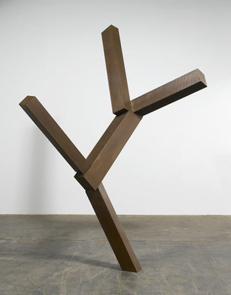
Content Standards
2nd Grade Benchmark:
“Through an exploration of art materials and techniques, students exercise imagination, construct meanings, and depict their experiences; work in two-dimensional and three-dimensional art forms, use basic art tools, and gain knowledge of media and compositional elements”
“Students hone observation skills and discuss works of art; develop visual arts vocabulary to describe art making, the tools and techniques used to produce art; read and write about art to reinforce literacy skills, interpret artwork by providing evidence to support assertions; reflect on the process of making art”
NYC Blueprint for the Visual Arts, p. 8, 10.

Slide 11
Content Standards (cont’d)
NY State Visual Arts Standards (Elementary):
Students will…
Produce a collection of art works, in a variety of mediums, based on a range of individual and collective experiences
Know and use a variety of sources for developing and conveying ideas, images, themes, symbols, and events in their creation of art
Identify and use, in individual and group experiences, some of the roles and means for designing, producing, and exhibiting art works and discuss ways to improve them
http://www.p12.nysed.gov/ciai/arts/artstand/visual1.html

Slide 12
Materials
Wood blocks/scraps varying in sizes and shapes
Wood glue
Plastic cup
Medium-size brushes
Drawing paper
Pencil and erasers
Wipes

Slide 13
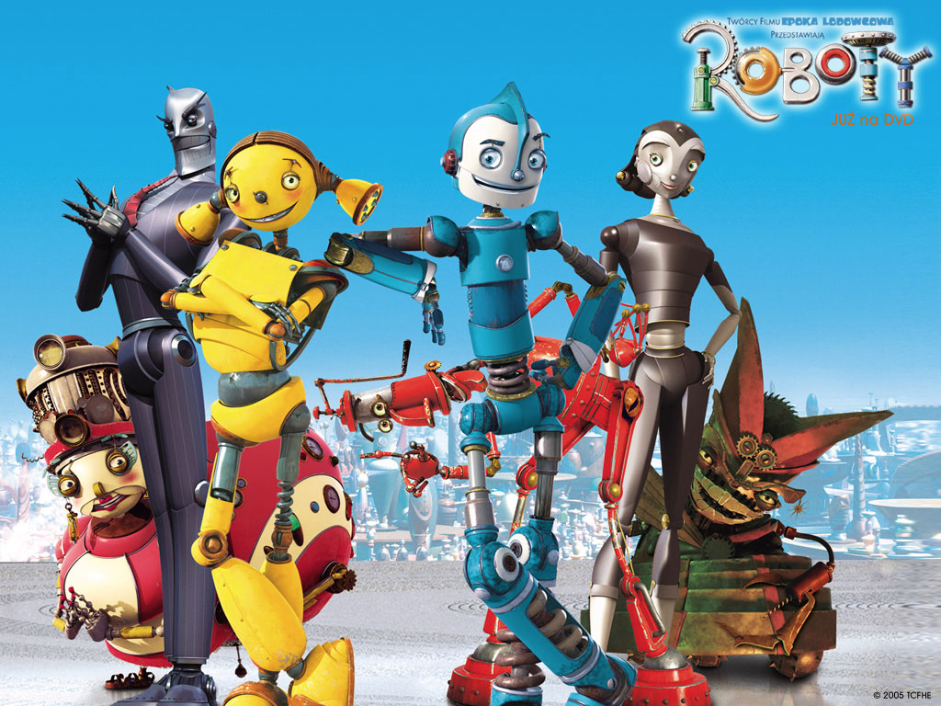
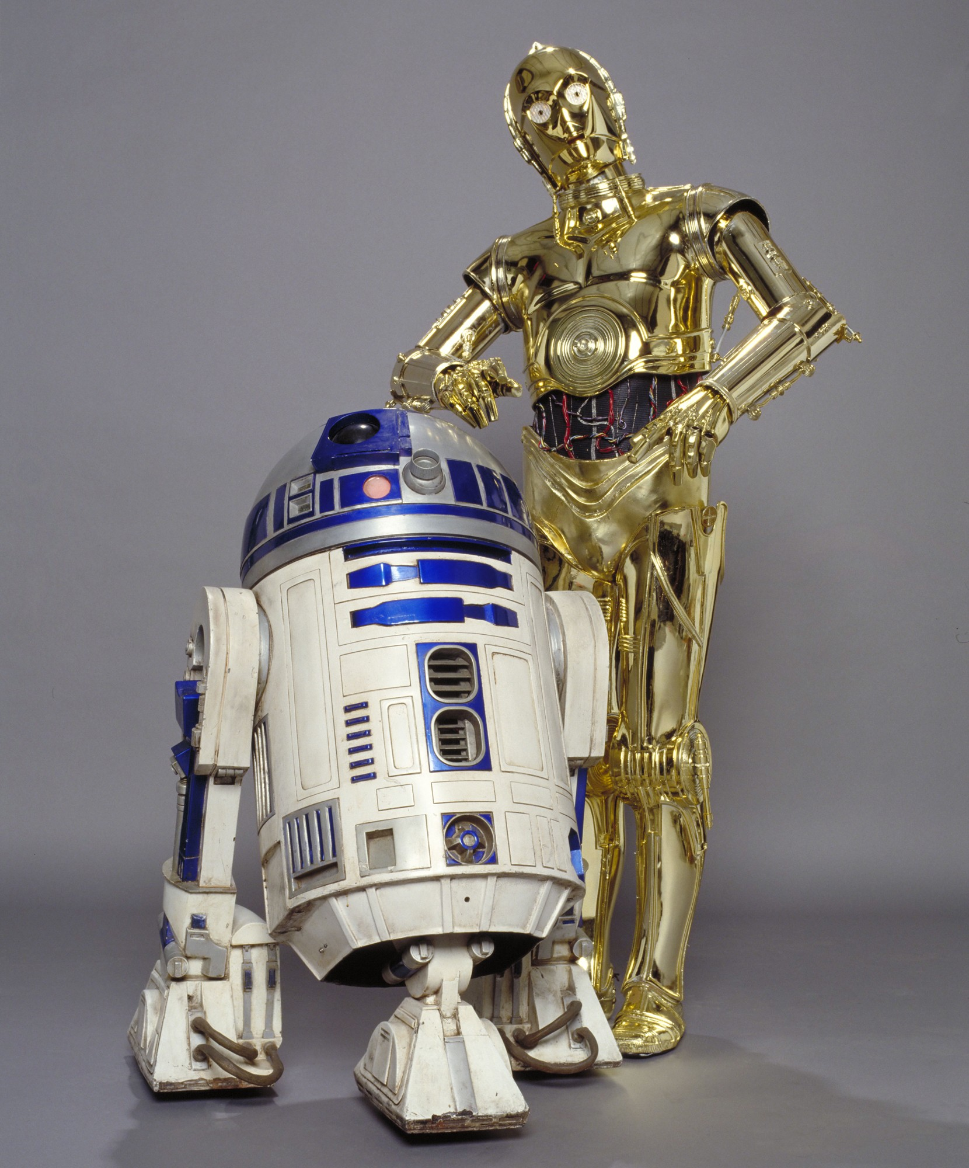
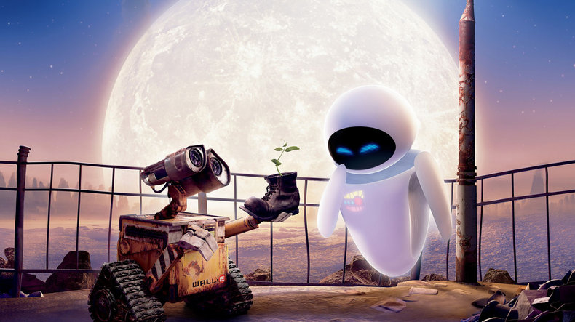
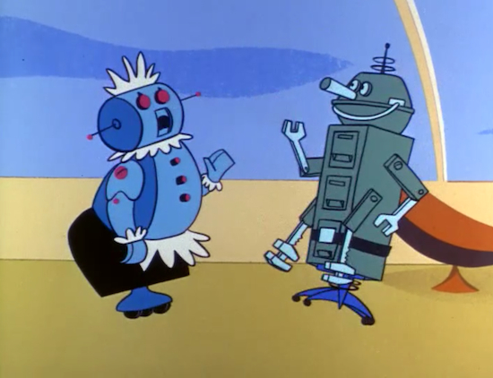
Visual Resources
Joel Shapiro’s works: large-scale abstract sculptures
Robot pictures from different sources: Wall-E, Star Wars, Transformers, Robots, Jetsons, The Iron Giant

Slide 14
Lesson 1
This lesson’s objective is for students to understand balance and weight distribution through discussion, experimentation and exploration through tactile materials as well as their own body.
Mini-challenges (individually, partners and in table groups)
Varying activities to address students’ readiness levels, learning preferences and to create an inclusive classroom

Slide 15
Lesson 2
This lesson focuses on building robots, gluing wood parts effectively and a conversation on the problems they face everyday (at home, school, classroom, playground/park, community…) and the jobs they would give their robots to solve these problems.
Video, picture slide show, visual word wall (symbol/words), lists, checklists to support students; language use.
Checklist worksheet which will list the criteria for their robots (self assessment)

Slide 16
Lesson 3
This lesson is a continuation from the previous lesson. Students will engage in a peer assessment to make additions and/or modifications from their peer’s suggestions and from the post-it feedback that I will have on each student’s project worksheet.
Short informal peer formative assessment: guessing each other’s robot’s jobs/take suggestions
“Two Stars and a Wish” peer review as exit slip

Slide 17
Lesson 4
This class will be devoted to drawing of their robots and a class share. The objective of this lesson is for students to use art language as well as academic language to explore and find relationships in their own artwork as well as their peers.
Students will compare and contrast their robots to Joel Shapiro’s sculptures as we revisit his work and/or their peers’ robots.
Emphasizes in the summative assessment of this learning segment

Slide 18
Formative Assessment 1
CHECKLIST
My robot is balanced
My robot has a job
My robot has a part that does its job
My robot has BIG and SMALL pieces of wood
All the parts are glued

Slide 19
Formative Assessment 2
Beginning of Lesson 3: Students will engage in informal peer assessment. Students will turn to their neighbors and try to guess each other’s robot’s job.
Student’s checklist from last class will be handed out with teacher’s feed-back on a post-it note.
After taking suggestions from their partners as well as reading teacher’s feedback, students will have more work time.

Slide 20
Summative Assessment 1
“Two Stars and a Wish!”
Artist’s Name: _____________________________
Reviewer: _________________________________
________________________________
________________________________
And a Wish! _________________________________
Please turn in this exit slip in the box before you leave the art studio

Slide 21
Summative Assessment 2
 | 3 | 2 | 1
Balance | Student shows evidence of using building support structures to create a free-standing robot with equal weight distribution | Student shows evidence of building support for robot to stand, but lack of equal weight distribution making the robot crooked/tip over easily | Student’s robot cannot stand
Glue Usage | Student’s robot sculpture parts are completely intact showing effective glue use | Some of student’s robot parts are dangling | Robot is falling apart; excess or too little glue use
Performance | Student shows evidence of understanding of balance and weight distribution. Student participates during discussion and contributes during class-share | Student works during work time but gets off track often. Student makes minimal contribution during class discussion | Student is distracted during discussion and work time/distracts others
Language | Student uses 2 or more vocabulary from word wall to describe, compare & contrast their work/others | Student uses 1 vocabulary word to describe their work; student compares and/or contrast (but not both) | Student does not use any of the vocabulary on wall to describe their work

